Slide 1
Trodelvy (Sacituzumab Govitecan)
in metastatic Breast Cancer approved indications
Slides set for speakers
Updated on 07/2024
Content of slides set:
Slides 3- 36: Trodelvy in mTNBC
Slides 37- 46: Administration & Safety
Slides 47- 55: Trodelvy in HR+/HER2- mBC
IL-TRO-0291

Slide 2
Disclaimer and important comments
The presentation is sponsored by Gilead Sciences Israel
Prof./Dr. [____] has provided consulting services to Gilead Sciences Israel [please update/delete as needed]
The data in this presentation is based on published clinical data.
2

Slide 3
Trodelvy (Sacituzumab Govitecan) in metastatic Triple Negative Breast Cancer
Slides set for speakers
Updated on 07/2024
IL-TRO-0291

Slide 4
Metastatic Triple-Negative
Breast Cancer

Slide 5

Triple-Negative Breast Cancer – a distinct subtype of breast cancer¹
Breast cancer is a heterogeneous disease² | Clinical subtypes are identified by their expression of²: hormone receptors (HRs) (estrogen receptors [ERs] and progesterone receptors [PRs] human epidermal growth factor receptor 2 (HER2)
Triple-Negative Breast Cancer (TNBC)
TNBC is characterised by tumours that do not express estrogen receptor (ER), progesterone receptor (PR), or overexpress human epidermal growth factor receptor 2 (HER2)
(“HER2 negative” defined by IHC0 & HER2 low (IHC1+ & IHC2+/ISH-))³
Accounts for 15%–20%
of all breast cancers³
TNBC In ISRAEL accounts for 11% of all breast cancers⁴
HER2, human epidermal growth factor receptor 2; TNBC, triple-negative breast cancer.
1. Plasilova ML, et al. Medicine (Baltimore). 2016;95(35):e4614.. 2. Rivenbark AG, O’Connor SM, Coleman WB. Am J Pathol. 2013;183(4):1113-24; 3. Antonio C. Wolff et al; Human Epidermal Growth Factor Receptor 2 Testing in Breast Cancer: American Society of Clinical Oncology–College of American Pathologists Guideline Update. Arch Pathol Lab Med 1 September 2023; 147 (9): 993–1000. doi: https://doi.org/10.5858/arpa.2023-0950-SA. 4. https://www.gov.il/BlobFolder/reports/breast-cancer-october2023/he/files_publications_units_ICDC_breast_cancer_october2023.pdf

Slide 6
mTNBC* is the most aggressive and difficult-to-treat breast cancer subtype^{1,2}
Median OS by subtype from the date of metastatic breast cancer diagnosis²
TNBC remains difficult to treat, in part due to:​
Aggressive and heterogenous tumour biology³​
Association with visceral metastases⁴
High risk of relapse (<3 years)⁴
Survival
probability
1.0
+ Censored
mHER2+ (n=59)
0.8
mHR+ (n=96)
54
months
(95% CI, 31–66)
mTNBC (n=44)
0.6
0.4
17
months
(95% CI, 10–22)
36
months
(95% CI, 28–49)
0.2
0.0
0
20
40
60
80
100
OS (months)
There is a significant need for more efficacious and tolerable treatment options in mTNBC⁵
Adapted from Seah DS, et al. 2014.
*Defined by a lack of tumour-cell expression of the oestrogen receptor, progesterone receptor, and HER2.
CI, confidence interval: mHER2, metastatic human epidermal growth factor receptor 2; mHR, metastatic hormone receptor; mTNBC, metastatic triple-negative breast cancer; OS, overall survival; TNBC, triple-negative breast cancer.
1. Fangyuan, et al. Oncotarget. 2017;8(42):73329-73344. 2. Seah DS, et al. J Natl Compr Canc Netw. 2014;12(1):71–80. 3. Abramson VG, et al. Cancer. 2015;121(1):8-16. 4. O’Reilly D, et al. World J Clin Oncol. 2021;12(3):164-182. 5. Lehmann BD, et al. J Clin Invest. 2011;121(7):2750–2767.

Slide 7
Global Guidelines For mTNBC

Slide 8
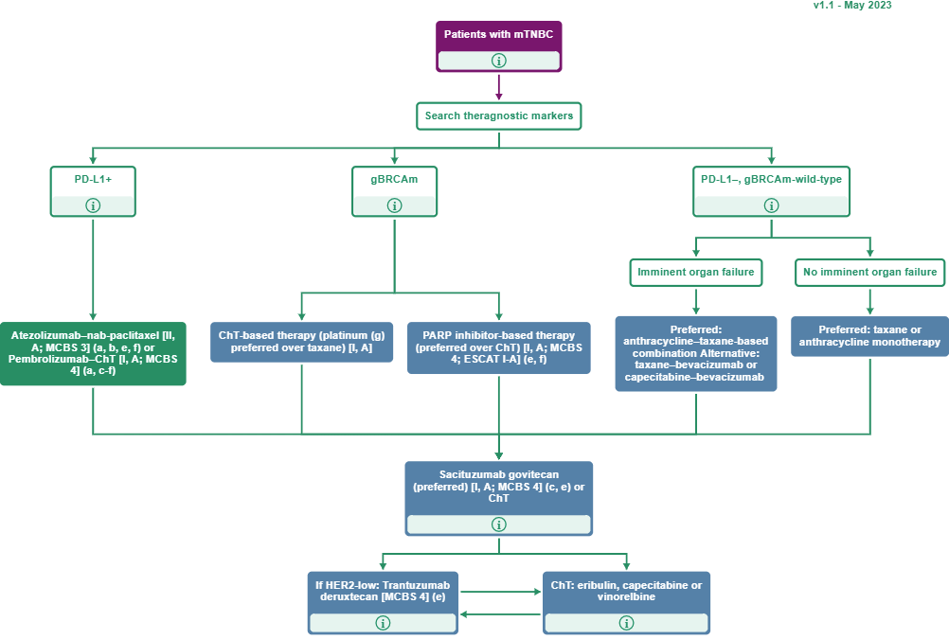
ESMO living Guidelines for mTNBC
(v1.1 May 2023) ¹
Purple: general categories or stratification; green: combination of treatments or other systemic treatments;
white: other aspects of management; blue: systemic anticancer therapy
(a) May be considered as monotherapy in further lines in case of high PD-L1 positivity and no previous exposure to ICI.
(b) EMA approved, not FDA approved.
(c) FDA approved, not EMA approved.
(d) ChT physician’s choice of nab-paclitaxel, paclitaxel or gemcitabine/carboplatin.
(e) ESMO-MCBS v1.1 (Cherny, 2017) was used to calculate scores for new therapies/indications approved by the EMA or FDA. The scores have been calculated by the ESMO-MCBS Working Group and validated by the ESMO Guidelines Committee (https://www.esmo.org/guidelines/esmo-mcbs/esmo-mcbs-evaluation-forms).
(f) ESCAT scores apply to genomic alterations only. These scores have been defined by the guideline authors and validated by the ESMO Translational Research and Precision Medicine Working Group. (Mateo, 2018)
(g) If not used previously.
ChT, chemotherapy; ESCAT, ESMO Scale for Clinical Actionability of Molecular Targets; gBRCAm, germline BRCA1/2 mutation;
ICI, immune checkpoint inhibitor; MCBS, ESMO-Magnitude of Clinical Benefit Scale; mTNBC, metastatic triple-negative breast cancer; PARP, poly (ADP-ribose) polymerase; PD-L1, programmed death-ligand
1. Ann Oncol 2021;32(12): 1475-1495" and this online publication: ESMO Metastatic Breast Cancer Living Guidelines, v1.1 May 2023 2. TRODELVY (sacituzumab govitecan) Israeli prescribing information approved by MoH https://israeldrugs.health.gov.il/#!/medDetails/170%2064%2037173%2000
*Trodelvy as monotherapy is indicated for the treatment of adult patients with unresectable or metastatic triple-negative breast cancer who have received two or more prior systemic therapies, including at least one of them for advanced disease.²
Notes:
Purple: general categories or stratification; green: combination of treatments or other systemic treatments; white: other aspects of management; blue: systemic anticancer therapy.
ChT, chemotherapy; EMA, European Medicines Agency; ESCAT, ESMO Scale for Clinical Actionability of Molecular Targets; FDA, Food and Drug Administration; gBRCAm, germline BRCA1/2 mutation; ICI, immune checkpoint inhibitor; MCBS, ESMO-Magnitude of Clinical Benefit Scale; mTNBC, metastatic triple-negative breast cancer; PARP, poly (ADP-ribose) polymerase; PD-L1, programmed death-ligand 1.
(a) May be considered as monotherapy in further lines in case of high PD-L1 positivity and no previous exposure to ICI.
(b) EMA approved, not FDA approved.
(c) FDA approved, not EMA approved.
(d) ChT physician’s choice of nab-paclitaxel, paclitaxel or gemcitabine/carboplatin.
(e) ESMO-MCBS v1.1 (Cherny, 2017) was used to calculate scores for new therapies/indications approved by the EMA or FDA. The scores have been calculated by the ESMO-MCBS Working Group and validated by the ESMO Guidelines Committee (https://www.esmo.org/guidelines/esmo-mcbs/esmo-mcbs-evaluation-forms).
(f) ESCAT scores apply to genomic alterations only. These scores have been defined by the guideline authors and validated by the ESMO Translational Research and Precision Medicine Working Group. (Mateo, 2018)
(g) If not used previously.

Slide 9
Updated:
ESMO MCBS score for Trodelvy in mTNBC is 5
https://www.esmo.org/guidelines/esmo-mcbs/esmo-mcbs-for-solid-tumours/esmo-mcbs-scorecards/scorecard-271-1
MCBS= (Magnitude of Clinical Benefit Score)

Slide 10
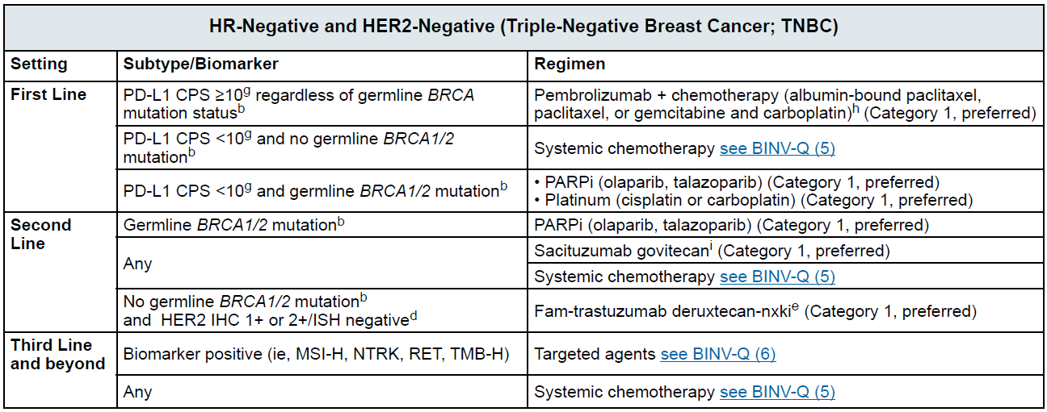
NCCN Recommendations for mTNBC
Adapted from the NCCN Guidelines
† According to the 5th ESO-ESMO international consensus guidelines (Cardoso F, et al. Ann Oncol 2020;31:1625) for advanced breast cancer visceral crisis is defined as: “severe organ dysfunction, as assessed by signs and symptoms, laboratory studies and rapid progression of disease. Visceral crisis is not the mere presence of visceral metastases but implies important organ compromise leading to a clinical indication for the most rapidly efficacious therapy.”
a For treatment of brain metastases, see NCCN Guidelines for Central Nervous System Cancers.
b Assess for germline BRCA1/2 mutations in all patients with recurrent or metastatic breast cancer to identify candidates for PARP inhibitor therapy.
c PARPi can be considered for a later line for those with BRCA1/2 mutation, however available evidence suggests it is more effective if used earlier.
d See Principles of HER2 Testing (BINV-A).
e Fam-trastuzumab deruxtecan maybe considered in a later line for HER2 IHC 1+ or 2+/ISH negative, if not used in second–line. Fam-trastuzumab deruxtecan-nxki
is associated with interstitial lung disease (ILD)/pneumonitis. Regular monitoring for this serious side effect is recommended. For patients with a history of ILD/
pneumonitis, there are no data on managing safety or toxicity of this drug in a trial.
f Sacituzumab govitecan-hziy may be used for adult patients with HR-positive, HER2-negative metastatic/locally advanced unresectable breast cancer after prior treatment including endocrine therapy, a CDK4/6 inhibitor, and at least two lines of chemotherapy, one of which was a taxane, and at least one of which was in the metastatic setting. It may be considered for later line if not used as second line therapy.
Version 4.2023, 03/23/23 © 2023 National Comprehensive Cancer Network® (NCCN®), All rights reserved. NCCN Guidelines® : https://www.nccn.org/guidelines/guidelines-detail?category=1&id=1419 (Version4. 2023)
Notes:
גם ב-NCCN גיידליינס אנחנו רואים שטרודלווי מומלץ ברמת המלצה הגבוה ביותר של קטגוריה 1, עבור קו שני ב-mTNBC

Slide 11
TRODELVY (Sacituzumab Govitecan) in mTNBC

Slide 12

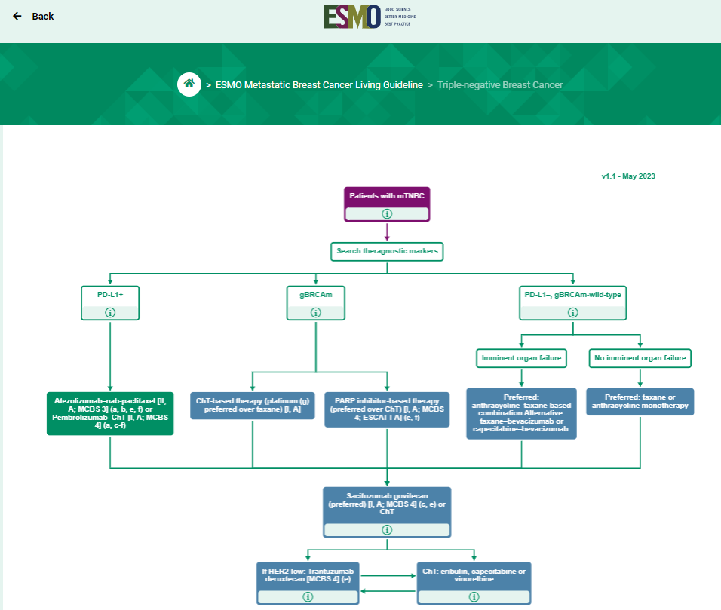
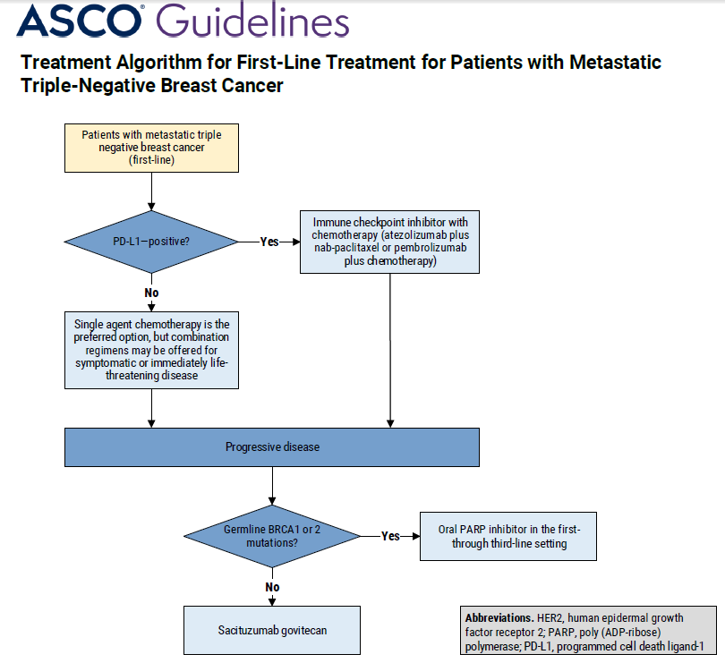
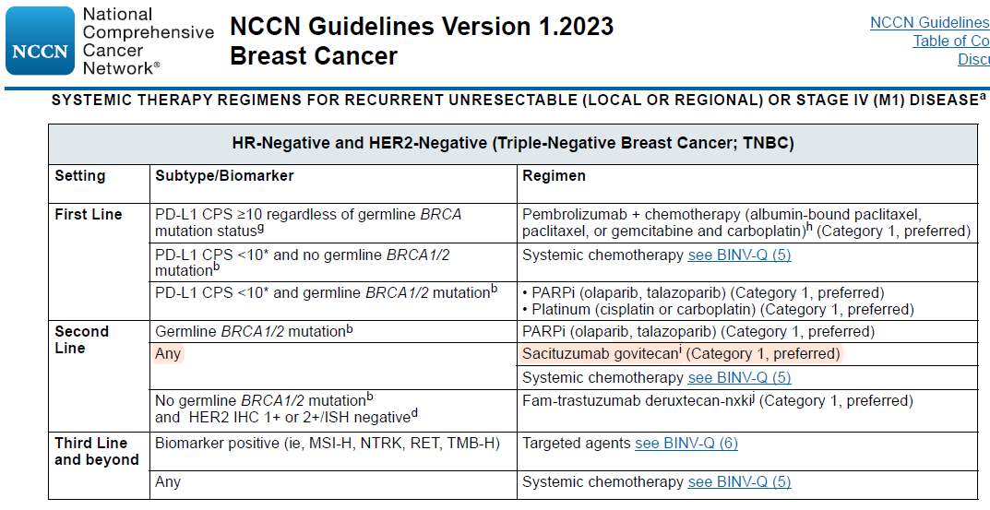




Global guidelines recommend Trodelvy for as early as 2nd line mTNBC
Full Indication
Trodelvy as monotherapy is indicated for the treatment of adult patients with unresectable or metastatic triple-negative breast cancer (mTNBC) who have received two or more prior systemic therapies, including at least one of them for advanced disease.
Trodelvy is indicated for the treatment of adult patients with unresectable locally advanced or metastatic HR+/HER2- (IHC 0, IHC 1+ or IHC 2+/ISH–) breast cancer who have received endocrine-based therapy and at least two additional systemic therapies in the metastatic setting
mTNBC
HR+/HER2-
Contraindications:
Hypersensitivity to the active substance or to any of these excipients:
2-(N-morpholino)ethane sulfonic acid (MES) | Polysorbate 80 (E433) | Trehalose dihydrate
ESMO score 5¹
(mTNBC)
²
Category 1³
1.ESMO: https://www.esmo.org/newsroom/press-office/metastatic-breast-cancer-new-esmo-guideline-with-evidence-based-recommendations ,https://www.annalsofoncology.org/article/S0923-7534(21)04498-7/fulltext . Accessed October 21, 2021; Gennari A, Barrios C H, Cortés J, et al. Guideline for the diagnosis, staging and treatment of patients with metastatic breast cancer. Annals of Oncol. 2021; doi: https://doi.org/10.1016/j.annonc.2021.09.019. & https://www.esmo.org/guidelines/esmo-mcbs/esmo-mcbs-for-solid-tumours/esmo-mcbsscorecards/scorecard-271-1
2. ASCO – American Society of Clinical Oncology. Published on July 29, 2021. www.asco.org/breast-cancer-guidelines. 3. NCCN- Guidelines in oncology (NCCN guidelines). Breast cancer NCCN Evidence Blocks, Version 1.2023 — January 27, 2023. https://www.nccn.org/guidelines/guidelines-detail?category=1&id=1419 . 4. TRODELVY (sacituzumab govitecan) prescribing information approved by Israeli ministry of health

Slide 13


Trodelvy is Reimbursed in National Health service as of 2024
https://www.gov.il/he/pages/mk02-2024

Slide 14
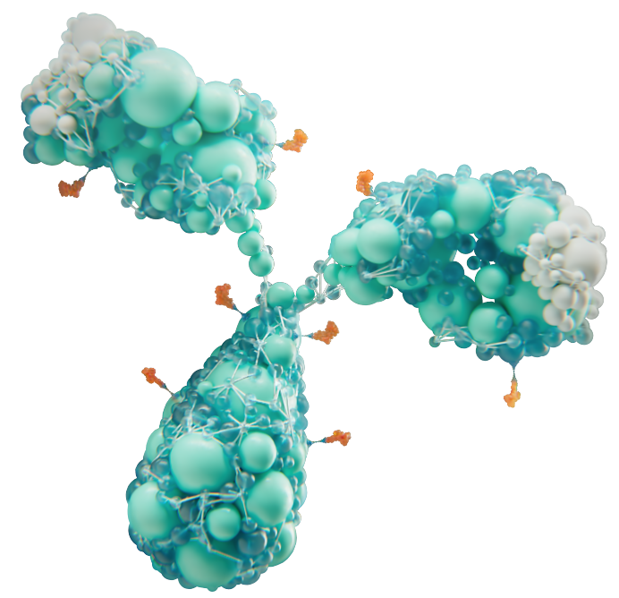
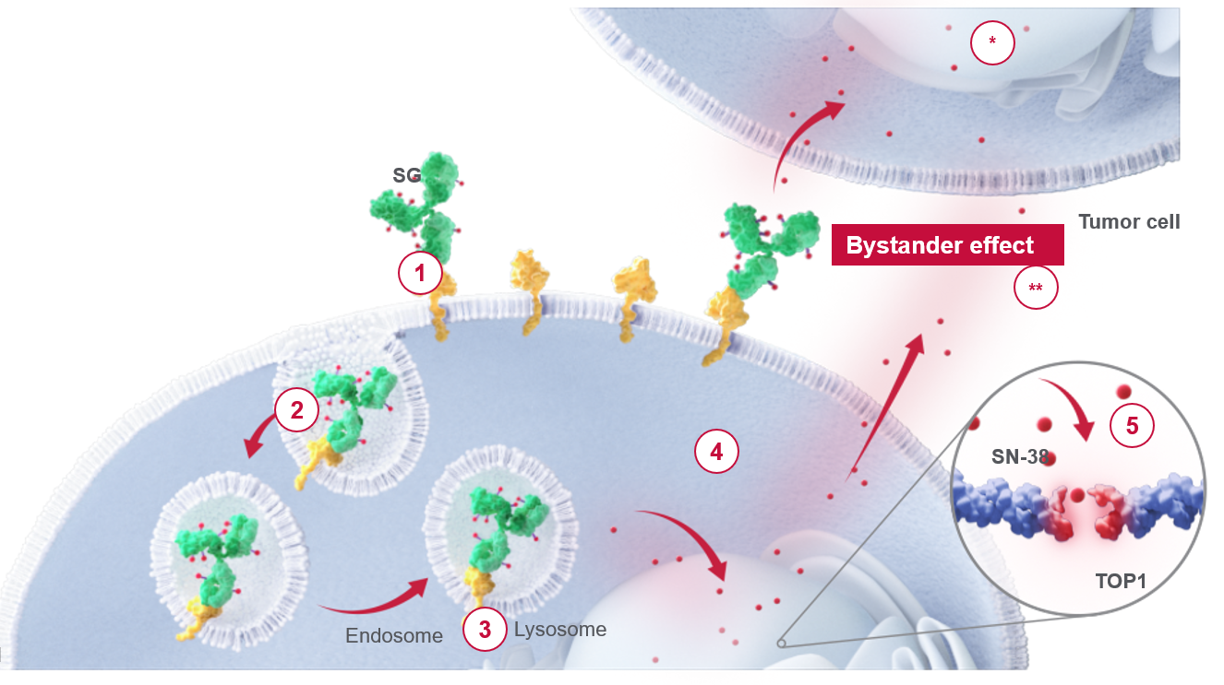
TRODELVY: The First And Only Approved TROP-2-directed ADC¹
TROP-2 DIRECTED mAB
Humanised monoclonal antibody^{2,3}
TROP-2 is a cell surface antigen highly expressed in multiple tumour types, including in >90% of breast cancer⁴⁻⁶
Binding
Internalization
Intracellular trafficking
Lysosomal degradation
Cell cytotoxicity
Bystander effect
HYDROLYSABLE LINKER
pH-sensitive, hydrolysable linker facilitates rapid release of SN-38 following internalization in cancer cells and subsequently to neighboring tumour cells, enabling a bystander effect^{2,3,9}
Limits the quantity of free SN-38 in the serum⁸
SN-38 (CYTOTOXIC PAYLOAD)
SN-38 is a potent topoisomerase 1 inhibitor with moderate toxicity, permitting delivery in high quantity to the tumour^{7,8}
High drug-to-antibody ratio of ~1:8^{2,3}
  Tumor cell
  Cell death due to DNA damage
Intracellular SN-38 release after internalization/DNA damage to targeted cell and bystander effect on adjacent tumour cells
Activity for TRODELVY was noted across TROP-2 expression levels and therefore TROP-2 testing is not required for treatment initiation with TRODELVY^{10,11}
2L, second line; ADC, antibody-drug conjugate; mTNBC, metastatic triple-negative breast cancer; TROP-2, trophoblast antigen 2.​
1. Bardia A, et al. Presented at the Virtual 2020 ESMO Congress. 2. Rugo HS, et al. Future Oncol. 2020;16(12):705–715. 3. Goldenberg DM, et al. Oncotarget. 2015;6(26):22496–22512. 4. Stepan LP, et al. J Histochem Cytochem. 2011;59(7):701-710. 5. Shvartsur A, et al. Genes Cancer. 2015;6(3-4):84-105. 6. Bardia A, et al. N Engl J Med. 2021;384(16):1529–1541. 7. Goldenberg DM, et al. Exp Opin Biol Ther. 2020;20(8):871–885. 8. Sharkey RM, et al. Clin Cancer Res. 2015;21(22):5131-5138. 9. Cardillo TM, et al. Clin Cancer Res. 2011;17(10):3157-3169. 10. Loriot Y, et al. Presented at the Virtual 2020 ESMO Congress. 11. TRODELVY (sacituzumab govitecan) prescribing information approved by Israeli ministry of health

Slide 15
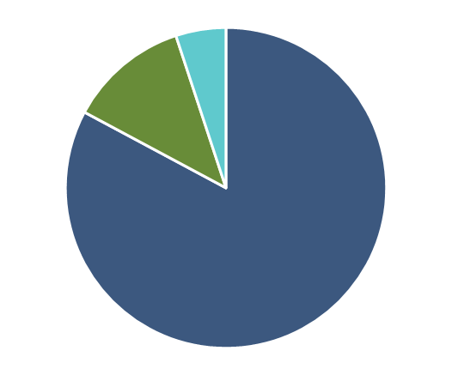
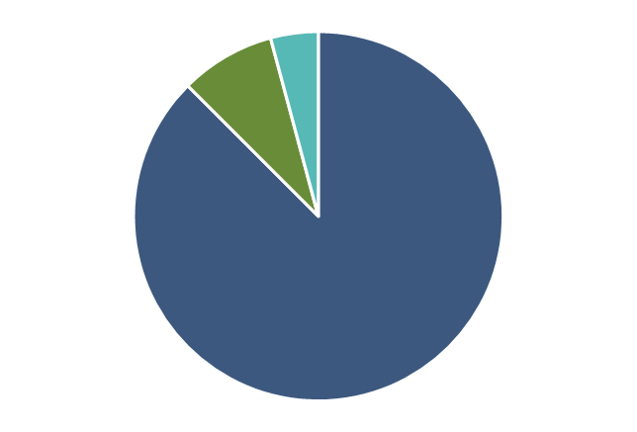
High Trop-2 Expression in mTNBC and HR+/HER2- mBC¹⁻³
Trop-2 is expressed in 96% of patients with mTNBC¹⁻² and approximately 95% of patients with HR+/HER2- mBC³
Trop-2 Expression in Patients with mTNBC (N=290)^{1-2,a,b}
Trop-2 Expression in Patients with HR+/HER2- mBC (N=238)^{3,c,d​}
4%
None
H-score = 0
5%
None
H-score = 0
16%
Low
H-score <100
12%
Low
0 < H-score ≤ 10
80%
Medium to High
100 ≤ H-score ≤ 300
82%
Medium to High
10 < H-score ≥ 100
High Trop-2 expression rates observed in mTNBC and HR+/HER2- mBC suggests that
pre-therapy biomarker assessment in these patients is not required.¹⁻³.
^{a,}Trop-2 expression was determined on primary or metastatic archival tumor tissue; ^{b,}Trop-2 expression was measured using a validated IHC assay in a central laboratory​. ^{c}Trop-2 expression was determined on primary or metastatic archival tumor tissue; ^{d,} membrane Trop-2 expression was assessed by a validated research IHC assay at a CAP/CLIA central laboratory
IHC, immunohistochemistry; TNBC, triple-negative breast cancer; Trop-2, trophoblast cell surface antigen-2, HER2–, human epidermal growth factor receptor 2-negative; HR+, hormone receptor-positive; H-score, histochemical score; mBC, metastatic breast cancer
1. Hurvitz SA, et al. SABCS [virtual meeting]. 2020 (oral presentation GS3-06), 2. Bardia A, et al. Ann Oncol. 2021, 3.Rugo HS, et al. Presented at SABCS 2022 (oral presentation, GS1-11)

Slide 16
Trodelvy (Sacituzumab Govitecan) in 2L+ Metastatic Triple-Negative Breast Cancer
ASCENT Clinical Trial
1.Bardia A, et al. N Engl J Med. 2021;384(16):1529-1541.
2.Bardia A et al., Final Results From the Randomized Phase III ASCENT Clinical Trial in Metastatic Triple-Negative Breast Cancer and Association of Outcomes by Human Epidermal Growth Factor Receptor 2 and Trophoblast Cell Surface Antigen 2 Expression. JCO, 2024

Slide 17
ASCENT: Study design¹
Stratification factors
Number of prior chemotherapies (2-3 vs >3)
Geographic region (North America vs Europe)
Presence/absence of known brain metastases (yes/no)
Metastatic TNBC
≥2 chemotherapies for advanced disease
One of the required prior regimens could be from progression that occurred within
a 12-month period after completion of neoadjuvant therapy
Patients with stable brain metastases
were allowed
N = 529
Sacituzumab govitecan (SG)
10 mg/kg IV
Days 1 & 8, every 21 days
n = 267
Continue treatment until progression or unacceptable toxicity
Endpoints
Primary
PFS (assessed by BICR in BMNeg populationª)
Secondary
PFS and OS for ITT (full population)^{b}
OS, ORR, DOR, TTR, safety, QoL
R 1:1
Treatment of physician’s choice (TPC)
n = 262
Eribulin
(1.4 mg/m² IV on Days 1 and 8 of a 21-day cycle)
n = 139
Capecitabine (1000-1250 mg/m² orally twice daily on Days 1-14 of a 21-day cycle)
n = 52
Gemcitabine
(800-1200 mg/m² IV on Days 1, 8 and 15 of a 28-day cycle)
n = 38
Vinorelbine
(25 mg/m² IV on Day 1 weekly)
n = 33
ªPFS measured by an independent centralized and blinded group of radiology experts who assessed tumor response using RECIST 1.1 criteria in patients without brain metastases; ^{b}The full population includes all randomized patients (with and without brain metastases).
BMNeg, brain metastases-negative; BICR, blind independent central review; DOR, duration of response; IV, intravenous; mTNBC, metastatic triple-negative breast cancer; ORR, objective response rate; OS, overall survival; PFS, progression-free survival; R, randomization; RECIST, Response Evaluation Criteria In Solid Tumors; SG, sacituzumab govitecan; TPC, treatment of physician's choice; TTR, time to response; QoL; quality of life.
1. Bardia A, et al. N Engl J Med. 2021;384(16):1529-1541.

Slide 18
ASCENT: Demographics and baseline characteristics¹
ITT population
Patients included: relapsed/refractory mTNBC [HER2 IHC0, IHC1+, IHC 2+/ISH- ; ER/PR <1%] after ≥2 previous standard chemotherapy regimens for unresectable, locally advanced, or metastatic disease¹
 | Trodelvy (n = 267) | TPC (n = 262)
Female—no. (%) | 265 (99) | 262 (100)
Median age—yr (range) | 54 (29-82) | 53 (27-81)
Race or ethnic group—no. (%)
White | 215 (81) | 203 (77)
Black | 28 (10) | 34 (13)
Asian | 13 (5) | 9 (3)
Other or not specified | 11 (4) | 16 (6)
ECOG PS—no. (%)
0 | 121 (45) | 108 (41)
1 | 146 (55) | 154 (59)
TNBC at initial diagnosis^{b}—no. (%)
Yes | 192 (72) | 180 (69)
 | Trodelvy (n = 267) | TPC (n = 262)
No. of previous systemic therapies, No. (%)
2-3 | 184 (69) | 181 (69)
≥3 | 83 (31) | 81 (31)
Previous systemic regimens —No. median(range)^{b} | 4 (2-17) | 4 (2-14)
Previous use of checkpoint inhibitors—No. (%) | 79 (30) | 74 (28)
Setting of previous systemic therapies, No.(%)
Adjuvant | 161 (60) | 148 (56)
Neoadjuvant | 124 (46) | 125 (48)
Metastatic | 258 (97) | 260 (99)
Locally advanced disease | 10 (4) | 5 (2)
BRCA1/2 mutation status. No. (%)
Negative | 150 (56) | 146 (56)
Positive | 20 (7) | 23 (9)
1. Aditya Bardia et al., Final Results From the Randomized Phase III ASCENT Clinical Trial in Metastatic Triple-Negative Breast Cancer and Association of Outcomes by Human Epidermal Growth Factor Receptor 2 and Trophoblast Cell Surface Antigen 2 Expression. JCO, 2024
Patients (relapsed/refractory mTNBC [HER2 IHC0, 1, or 2/ISH-negative; ER/PR <1%]¹⁸⁻²⁰ after ≥2 previous standard chemotherapy regimens for unresectable, locally advanced, or metastatic disease) were randomly assigned 1:1 to either SG or TPC until disease progression, unacceptable toxicity, study withdrawal, or death, whichever occurred first. Patients with known brain metastases were capped at 15%. Abbreviations: BRCA, breast cancer gene; ECOG, Eastern Cooperative Oncology Group; ER, estrogen receptor; HER2, human epidermal growth factor receptor 2; IHC, immunohistochemistry; ITT, intention-to-treat; mTNBC, metastatic triple-negative breast cancer; PR, progesterone receptor; SG, sacituzumab govitecan; TNBC, triple-negative breast cancer; TPC, treatment of physician’s choice; Trop-2, trophoblast cell surface antigen 2.
ªRace was self-reported. Other includes American Indian or Alaska Native, Native Hawaiian, or other Pacific Islander.
^{b}Anticancer regimens refer to any treatment regimen that was used to treat breast cancer in any setting.
^{c}Positive denotes that the patient is either BRCA1-positive or BRCA2-positive. Negative denotes that the patient is both BRCA1-negative and BRCA2- negative.
Notes:
18. Allison KH, Hammond MEH, Dowsett M, et al: Estrogen and progesterone receptor testing in breast cancer: ASCO/CAP guideline update. J Clin Oncol 38:1346-1366, 2020
19. Hammond ME, Hayes DF, Dowsett M, et al: American Society of Clinical Oncology/College of American Pathologists guideline recommendations for immunohistochemical testing of estrogen and
progesterone receptors in breast cancer. J Clin Oncol 28:2784-2795, 2010
20. Wolff AC, Hammond MEH, Allison KH, et al: Human epidermal growth factor receptor 2 testing in breast cancer: American Society of Clinical Oncology/College of American Pathologists clinical
practice guideline focused update. J Clin Oncol 36:2105-2122, 2018

Slide 19
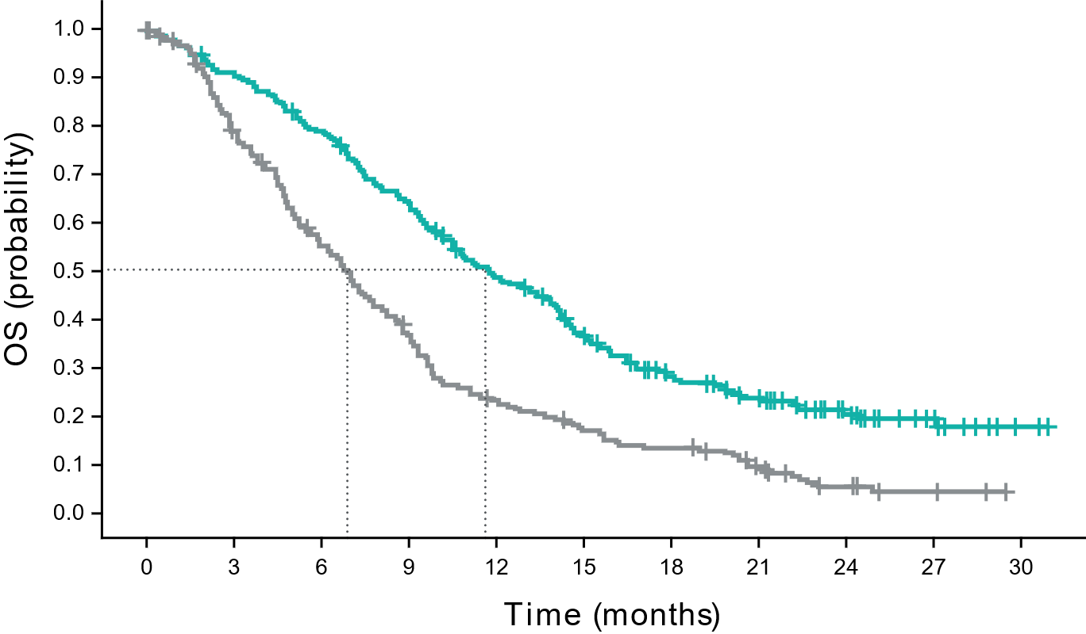
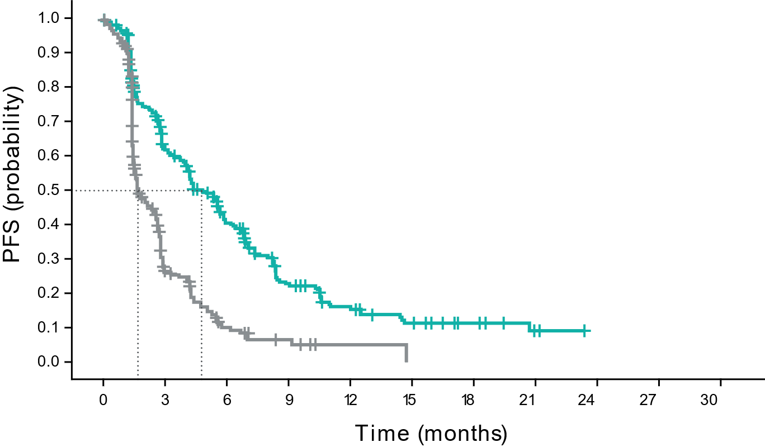
Trodelvy Demonstrated Significant Survival Benefit Over TPC, With OS Rate at 24m of 20.5% vs 5.5% With TPC (ITT population)
Progression-Free Survival¹
Overall Survival¹
HR= 0.41
(95% CI:0.33-0.52)
HR= 0.51
(95% CI:0.42-0.63)
SG
mPFS:4.8mo
(4.1-5.8)
SG
mOS:11.8 mo
(10.5-13.8)
TPC
mOS:6.9 mo
(5.9-7.7)
∆=4.9 m
OS rate at 24m²
∆=3.1 m
TPC
mPFS:1.7mo
(1.5-2.5)
SG: 20.5%
TPC: 5.5%
Adapted from Bardia A, et al. JCO. 2024
Adapted from Bardia A, et al. JCO. 2024
Includes all randomly assigned patients (with or without brain metastasis)
P<0.0001
Assessed by independent central review in the ITT population. The PFS improvement in the primary analysis population (median PFS: 5.6 months vs 1.7 months; HR: 0.41; P<.0001) was consistent with the ITT population, The OS improvement in the primary analysis population (median OS: 12.1 months vs 6.7 months; HR: 0.48; P<.0001) was consistent with the ITT population . The primary analysis population consisted of patients without present or prior history of brain metastases at baseline (n=468). The ITT population consisted of patients with or without brain metastases at baseline (N=529). ITT population final database lock 25 February 2021.1
CI, confidence intervals; HR, hazards ratio; ITT, intention to treat; n, number of patients; OS, overall survival; PFS, progression-free survival; SG; sacituzumab govitecan; TPC, treatment of physician’s choice
1. Aditya Bardia et al., Final Results From the Randomized Phase III ASCENT Clinical Trial in Metastatic Triple-Negative Breast Cancer and Association of Outcomes by Human Epidermal Growth Factor Receptor 2 and Trophoblast Cell Surface Antigen 2 Expression. JCO, 2024, 2) Bardia A, et al. ASCO 2022. Pster 1071 ; Sacituzumab govitecan (SG) versus treatment of physician’s choice (TPC) in patients (pts) with previously treated, metastatic triple-negative breast cancer (mTNBC): Final results from the phase 3 ASCENT study.
Notes:
Draft SMPC, Table 3
Draft SMPC, Fig 3
Draft SMPC, Fig 4
Draft SMPC, Table 3

Slide 20
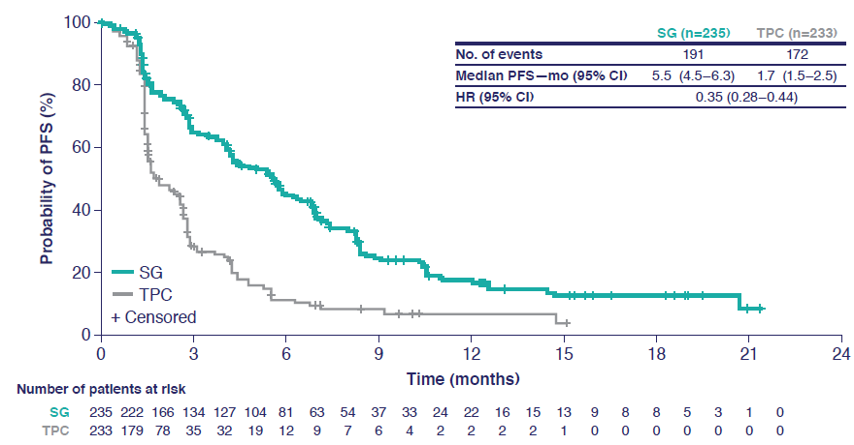
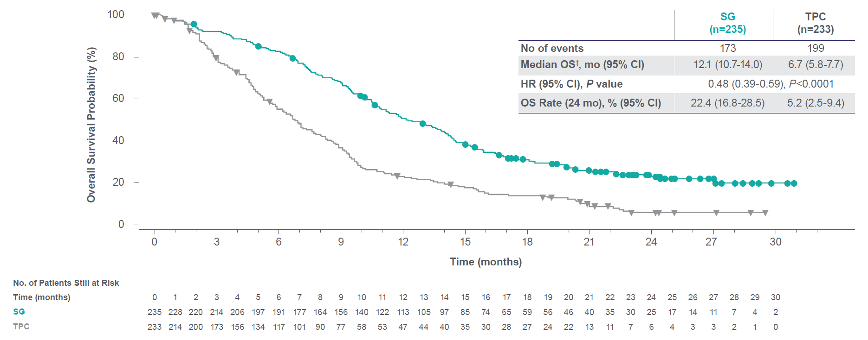
Trodelvy demonstrated significant improvement over single-agent chemotherapy (bmneg population)
Primary end point
Progression-Free Survival¹
Overall Survival¹
HR= 0.48
(95% CI:0.39-0.59), p<0.0001
HR= 0.39
(95% CI:0.31-0.49), p<0.0001
SG
mOS:12.1 mo
(10.7-14.0)
SG
mPFS:5.6mo
(4.3-6.3)
TPC
mPFS:1.7mo
(1.5-2.6)
TPC
mOS:6.7 mo
(5.8-7.7)
No. at Risk
SG | 235 | 214 | 190 | 153 | 107 | 70 | 37 | 13 | 0
TPC | 233 | 173 | 117 | 74 | 45 | 30 | 11 | 3 | 1
According the final data analysis: OS rate at 24 months of
22.4% (95%CI, 16.8-28.5) vs. 5.2% (95%CI, 2.5-9.4) In SG and TPC, respectively²
Follow up analysis from the final database lock (Feb ‘21) continues to show benefit of SG over single agent chemotherapy in PFS and OS outcomes
*PFS is defined as the time from the date of randomization to the date of the first radiological disease progression or death due to any cause, whichever comes first. †Median PFS is from Kaplan-Meier estimate. CI for median is computed using the Brookmeyer-Crowley method. Stratified log-rank test and stratified Cox regression adjusted for stratification factors: number of prior chemotherapies and region.
BMNeg, brain metastasis-negative; CI, confidence intervals; HR, hazard ratio; PFS, progression free survival; SG, sacituzumab govitecan; TPC, treatment of physician's choice.
1. Bardia A, et al. Presented at ASCO 2022 (abstract ID #1071). Sacituzumab govitecan (SG) versus treatment of physician’s choice (TPC) in patients (pts) with previously treated metastatic triple-negative breast cancer (mTNBC): Final results from the Phase 3 ASCENT study.

Slide 21
Trodelvy demonstrated significant improvement in ORR over standard single-agent chemotherapy (ITT population)
Objective response¹
 | Trodelvy (n = 235) | TPC (n = 233)
ORR, n(%) | 83 (31) | 11 (4)
P valueª | <0.0001
Best overall response, n (%)^{b}
CR | 10 (4) | 2 (1)
PR | 73 (27) | 9 (3)
Clinical benefit Rate, n (%)^{c} | 108 (40) | 21 (8)
P valueª | <0.0001
Median DOR, mo (95% CI)^{d} | 6.3 (5.5−7.9) | 3.6 (2.8−NE)
ª The P value is based on the Cochran-Mantel-Haenszel test.
^{b} Objective response is defined as the best confirmed overall response of either CR or PR. The best overall response is derived based on independent review assessed tumor response at each tumor assessment according to RECIST 1.1. Responses of CR and PR are confirmed no less than 4 weeks later. SD requires a minimum duration of 6 weeks to be classified as SD.
^{c} CBR is defined as the percentage of patients with a confirmed best overall response of CR or PR, and SD with a duration of at least 6 months. d Only patients achieving CR or PR are included in the analysis of DOR and TTR. Median DOR is from Kaplan-Meier estimate. CI for median is computed using the Brookmeyer-Crowley method. Abbreviations: CR, complete response; ITT, intention-to-treat; NE, not evaluable; ORR, objective response rate; PD, progressive disease; PR, partial response; SD, stable disease; SG, sacituzumab govitecan; TPC, treatment of physician’s choice
1. Aditya Bardia et al., Final Results From the Randomized Phase III ASCENT Clinical Trial in Metastatic Triple-Negative Breast Cancer and Association of Outcomes by Human Epidermal Growth Factor Receptor 2 and Trophoblast Cell Surface Antigen 2 Expression. JCO, 2024, Supplementary

Slide 22




Trodelvy was generally associated with greater improvements and delayed worsening of HRQoL scores compared with TPC ¹
For global health status (GHS)/QoL, physical functioning, fatigue, and pain, changes from baseline were superior for SG versus TPC, statistically significant and clinically meaningful ¹
Global health
status/QoL
Physical
functioning
Fatigue
Pain
Based on these outcomes ESMO MCBS Score of TRODELVY in mTNBC was increased to the maximal 5 ²
MCBS (Magnitude of Clinical Benefit Score)
HRQoL, health-related quality of life.
Loibl S. et al., Health-related quality of life in the phase III ASCENT trial of sacituzumab govitecan versus standard chemotherapy in metastatic triple-negative breast cancer. Euro J Cancer. 2022 Oct 178.
https://www.esmo.org/guidelines/esmo-mcbs/esmo-mcbs-for-solid-tumours/esmo-mcbs-scorecards/scorecard-271-1

Slide 23
Trodelvy was generally associated with greater improvements and delayed worsening of HRQoL scores compared with TPC ¹
Overall least-square mean change from baseline during the first six cycles of treatment.
 | Least-square mean change from baseline (95% CI) |  |  | Non-inferiority margin (MID) [15]
 | SG (n = 236) | TPC (n = 183) | SG minus TPC
Primary-focused domains |  |  |  | Lower bound of 95% CI
Global health status/QoLª | 0.66 (-2.21 to 3.53) | -3.42 (-6.77 to -0.08) | 4.08 (0.82-7.35)* | -4
Physical functioning^{b} | 1.31 (-1.38 to 3.99) | -4.39 (-7.52 to -1.26) | 5.69 (2.63-8.76)** | -5
Role functioning^{b} | -2.24 (-6.13 to 1.65) | -7.83 (-12.41 to -3.25) | 5.59 (1.13-10.05)* | -6
 |  |  |  | Upper bound of 95% CI
Fatigue^{c} | 1.97 (-1.20 to 5.13) | 7.13 (3.40-10.87) | -5.17 (-8.81 to -1.52)** | +5
Pain^{c} | -8.93 (-12.57 to -5.30) | -1.89 (-6.18 to 2.40) | -7.04 (-11.24 to -2.85)** | +6
Secondary-focused domains |  |  |  | Lower bound of 95% CI
Emotional functioning^{b} | 3.34 (0.46-6.22) | -0.55 (3.94 to 2.84) | 3.89 (0.56-7.22)* | -3^{d}
Cognitive functioning^{b} | -1.22 (-4.00 to 1.56) | -1.98 (-5.21 to 1.24) | 0.76 (-2.36 to 3.89) | -3
Social functioning^{b} | -1.51 (-5.47 to 2.45) | -5.41 (-10.04 to -0.78) | 3.90 (-0.61 to 8.40) | -5
 |  |  |  | Upper bound of 95% CI
Nausea/vomiting^{c} | 4.30 (1.92-6.68) | 2.50 (-0.23 to 5.22) | 1.81 (-0.83 to 4.44) | +3
Dyspnoea^{c} | -3.79 (-7.52 to -0.06) | 3.95 (-0.51 to 8.40) | -7.74 (-12.13 to -3.35)** | +4
Insomnia^{c} | -4.69 (-8.92 to -0.46) | 0.34 (-4.64 to 5.32) | -5.03 (-9.89 to -0.16)* | +4
Appetite loss^{c} | 3.52 (-0.47 to 7.51) | 7.00 (2.31-11.68) | -3.47 (-8.05 to 1.11) | +5
Constipation^{c} | 2.16 (-1.76 to 6.08) | 2.69 (-1.89 to 7.27) | -0.53 (-4.97 to 3.91) | +5
Diarrhoea^{c} | 14.07 (9.94-18.20) | -1.27 (-6.08 to 3.54) | 15.34 (10.65 to 20.03)** | +3
Financial difficulties^{c} | -2.87 (-6.39 to 0.65) | 0.68 (-3.50 to 4.86) | -3.55 (7.69 to 0.59) | +3
 |  |  |  | Lower bound of 95% CI
EORTC QLQ-C30 summary scoreª | -0.67 (-2.73 to 1.39) | -3.15 (-5.54 to -0.75) | 2.48 (0.14-4.81)* | -5^{c}
CI, confidence interval; MID, minimal important difference; QoL, quality of life; SG, sacituzumab govitecan; TPC, treatment of physician’s choice.
Bold: SG superior to TPC based on the MID and significance testing.
Underlined: SG inferior to TPC (upper bound of the 95% CI greater than the non-inferiority margin).
*P < 0.05; **P < 0.01.
ª A higher score represents better QoL.
^{b} A higher score represents better functioning.
^{c} A higher score represents worse symptomatology.
^{d} The between-group MID could not be estimated, so a within-group MID based on a previously published threshold [17] was used instead.
^{e} For the EORTC QLQ-C30 summary score, the MID was derived as 0.3 SD for the overall sample (16.8) [18].
1. Loibl S. et al., Health-related quality of life in the phase III ASCENT trial of sacituzumab govitecan versus standard chemotherapy in metastatic triple-negative breast cancer. Euro J Cancer. 2022 Oct 178.

Slide 24
ASCENT: Safety profile¹
Trodelvy Was Well Tolerated, with a Manageable Safety Profile
All Grade: ≥ 10%; Grade ≥ 3: ≥ 5% of Patients
 |  | Trodelvy (n = 258) |  | TPC (n = 224)
 | TRAEª | All grade^{b}, % | Grade ≥3, % | All grade, % | Grade ≥3, %
Hematologic | Neutropenia^{b} | 64 | 52^{d} | 44 | 34
 | Anemia^{c} | 40 | 9 | 28 | 6
 | Leukopenia^{d} | 17 | 11 | 12 | 6
 | Lymphopenia^{e} | 10 | 2 | 6 | 2
 | Thrombocytopenia^{f} | 7 | 2 | 13 | 2
 | Febrile neutropenia | 6 | 6 | 3 | 3
Gastrointestinal | Diarrhea | 65 | 12 | 17 | 1
 | Nausea | 62 | 3 | 30 | <1
 | Vomiting | 34 | 2 | 16 | 1
Other | Fatigue | 52 | 4 | 40 | 9
 | Alopecia | 47 | 0 | 16 | 0
  The rate of AEs leading to treatment discontinuation was low (≤5%)
  Dose reductions due to TRAEs were similar (22% SG vs 26% TPC)
  The most common grade ≥3 TEAEs in the SG arm vs TPC arm in the overall safety population were neutropenia (52% vs 34%) and diarrhea (12% vs <1%).
In ASCENT, approximately 80% of patients stayed on the full TRODELVY dose without the need for a dose reduction
  G-CSF usage was 49% in the SG arm vs 23% in the TPC arm²
ªTreatment-emergent AE is defined as an adverse event with a start date on or after the date of first dose of study treatment and up to 30 days after date of last dose of study treatment. Patients are counted once if experiencing multiple adverse events. AEs were classified according to the MedDRA systems of preferred terms (version 22.1). ^{b}Combined neutropenia and neutrophil count decreased. ^{c} Combined anemia, hemoglobin decreased, red blood cell count decreased. ^{d}Combined leukopenia, white blood cell count decreased. ^{e}Combined lymphopenia, lymphocyte count decreased. ^{f}Combined thrombocytopenia, platelet count decreased. Abbreviations: AE, adverse event; SG, sacituzumab govitecan; TPC, treatment of physician’s choice.
. Aditya Bardia et al., Final Results From the Randomized Phase III ASCENT Clinical Trial in mTNBC and Association of Outcomes by HER2 and TROP2 Expression. JCO, 2024, Supplementary, 2. Bardia A, et al. N Engl J Med. 2021;384(16):1529-1541

Slide 25

Most instances of neutropenia occurred within the first 2 cycles and lasted about 1 week¹
In the ASCENT trial SG group:
Median time to neutropenia onset
Median duration of neutropenia
Any Grade
20 days
7 days
Grade ≥3
21 days
6 days
0%
46%
11%
Treatment discontinuation
due to neutropenia
or febrile neutropenia
Treatment interruption
due to neutropenia
or febrile neutropenia
Dose reduction
due to neutropenia
or febrile neutropenia
1. Rugo H, et al. Poster. SABCS [virtual meeting]. 2020 (abstr PS11-09).

Slide 26

Most instances of diarrhoea occurred within the first 2 cycles and lasted about 1 week¹
In the ASCENT trial TRODELVY group:
Median time to diarrhoea onset
Median duration of diarrhoea
Any Grade
12 days
5 days
Grade 3
19 days
5 days
0%
5%
5%
Treatment discontinuation
due to diarrhoea
Treatment interruption
due to diarrhoea
Dose reduction
due to diarrhoea
All events of Grade 3 diarrhoea in patients treated with
TRODELVY were resolved, and no Grade 4 events were reported
1. Rugo H, et al. Poster. SABCS [virtual meeting]. 2020 (abstr PS11-09).

Slide 27
ASCENT: Conclusions
The follow up analysis from the final database lock (February 25, 2021) continues to show benefit of Trodelvy over single-agent chemotherapy in PFS and OS outcomes, consistent with the primary analysis
Trodelvy was well tolerated, with a manageable safety profile, low treatment discontinuations due to AEs (<5%) and no treatment-related deaths, consistent with the primary analysis
Trodelvy was generally associated with greater improvements and delayed worsening of HRQoL scores compared with TPC.
These findings reinforce Trodelvy as an effective treatment option in patients with mTNBC in 2L or greater setting
AE, adverse event; mTNBC, metastatic triple negative breast cancer; OS, overall survival; PFS, progression free survival; QoL, quality of life; SG, sacituzumab govitecan; TPC, treatment of physician's choice; 2L, second line.
1. Bardia A, et al. Presented at ASCO 2022 (abstract ID #1071). Sacituzumab govitecan (SG) versus treatment of physician’s choice (TPC) in patients (pts) with previously treated metastatic triple-negative breast cancer (mTNBC): Final results from the Phase 3 ASCENT study.

Slide 28
Real-world Use Patterns, Effectiveness, and Tolerability of Sacituzumab Govitecan for Second-line and Later Treatment of Metastatic Triple-Negative Breast Cancer
Kevin Kalinsky¹, Laura Spring ², Clinton Yam ³, Ioanna Ntalla⁴, Brian Stwalley⁵,
Nikoleta Sjekloca ⁶, Catherine Lai ⁷, Alpana Kaushiva, ⁸, Aliki Taylor ⁹, Rita Nanda¹⁰
¹Hematology and Medical Oncology, Winship Cancer Institute, Emory University, Atlanta, GA, USA; ²Massachusetts General Hospital Cancer Center and Harvard Medical School, Boston, MA, USA; ³Department of Breast Medical Oncology, The University of Texas MD Anderson Cancer Center, Houston, TX, USA; ⁴Real-World Evidence, Gilead Sciences Europe Ltd., Stockley Park, UK; ⁵US Medical Affairs, Gilead Sciences, Inc., Foster City, CA, USA; ⁶Global Medical Affairs, Oncology, Gilead Sciences Europe Ltd., Stockley Park, UK; ⁷Clinical Development, Gilead Sciences, Inc., Foster City, CA, USA; ⁸Real-World Data & Evidence Department, ConcertAI, Cambridge, MA, USA; ⁹Department of Medicine, Section of Hematology/Oncology, The University of Chicago Medical Center, Chicago, IL, USA
Real-world outcomes in patients with mTNBC treated with Trodelvy sacituzumab govitecan (SG) in 2L+ in the United States (US)
Kalinsky, K., Spring, L., Yam, C. et al. Real-world use patterns, effectiveness, and tolerability of sacituzumab govitecan for second-line and later-line treatment of metastatic triple-negative breast cancer in the United States. Breast Cancer Res Treat (2024). https://doi.org/10.1007/s10549-024-07412-9
Kalinsky, K., Spring, L., Yam, C. et al. Real-world use patterns, effectiveness, and tolerability of sacituzumab govitecan for second-line and later-line treatment of metastatic triple-negative breast cancer in the United States. Breast Cancer Res Treat (2024). https://doi.org/10.1007/s10549-024-07412-9

Slide 29
Methods
This retrospective, observational cohort study used the ConcertAI Patient360™ dataset. Further data abstraction from physicians’ notes was used to identify patients with dose modifications (reductions and interruptions), treatment discontinuations, and real-world AEs (rwAEs) of interest
Patients diagnosed with mTNBC and treated with SG in the 2L and 3L+ setting from April 2020 to May 2022 were included
Real-world OS (rwOS), time to next treatment or death (TTNTD), and real-world PFS (rwPFS) were assessed using Kaplan-Meier analyses
SG dose modifications and treatment discontinuations were described using abstracted data. Concomitant granulocyte colony-stimulating factor (G-CSF) use was described
Real-world AEs (any grade) that occurred during SG treatment were described using abstracted data. Laboratory data and diagnosis were also used to identify patients with neutropenia
AEs, adverse events; BC, breast cancer; dx, diagnosis; HER2-, human epithelial growth factor 2-negative; IHC, Immunohistochemistry; ISH, in situ hybridization; mBC, metastatic breast cancer; mTNBC, metastatic triple-negative breast cancer; real-world overall survival, rwOS; SG, sacituzumab govitecan.
ªThe index date was defined as the start of SG occurring in any treatment line after diagnosis of mBC.
^{b}April 1, 2020 was chosen as the earliest index date because this was the date on which SG received US Food and Drug Administration accelerated approval for the treatment of mTNBC after ≥ 2 prior systemic therapies.
1. Kalinsky, K., Spring, L., Yam, C. et al. Real-world use patterns, effectiveness, and tolerability of sacituzumab govitecan for second-line and later-line treatment of metastatic triple-negative breast cancer in the United States. Breast Cancer Res Treat (2024).
29

Slide 30
Baseline Characteristics
 | RWE cohort 2L+ mTNBC (N=230)
Median age (IQR), years | 60 (49-69)
ECOG PS, n (%)
0-1 | 162 (70)
≥ 2 | 40 (17)
Unknown | 28 (12)
De novo mBC, n (%) | 41 (18)
Median time from mBC diagnosis to SG treatment start (IQR), months | 11.8 (7.6-19.2)
Brain metastasis, n (%) | 17 (7)
Visceral metastasis, n (%) | 167 (73)
PD-L1 expression status, n (%)
PD-L1 positive | 22 (10)
PD-L1 negative | 48 (21)
Unknown | 160 (70)
BRCA1/2 mutation status, n (%)
Mutant | 31 (13)
Wildtype | 108 (47)
Unknown | 91 (40)
Prior therapies in the metastatic setting
Anticancer regimens, median (IQR)ª | 2 (1-3)
Chemotherapy drugs, n (%)
Taxanes | 149 (65)
Anthracyclines | 26 (11)
Cyclophosphamide Carboplatin | 16 (7) 96 (42)
Capecitabine | 94 (41)
PARPi, n (%) | 15 (7)
PD-L1 inhibitors, n (%) | 111 (48)
Overall, 230 patients met the inclusion criteria
median age was 60 years, and 17% had an ECOG performance status ≥ 2
33% and 67% of patients received Trodelvy in 2L and in 3L+, respectively
At the end of the study period, 21 (9%) patients were still receiving Trodelvy
ER, estrogren receptor; HER2‒, human epidermal growth factor receptor; IHC, Immunohistochemistry; ISH, In Situ Hybridization; mTNBC, metastatic triple-negative breast cancer; PR, progesterone receptor; SG, Sacituzumab govitecan; rwOS, real-world overall survival.
1. Kalinsky, K., Spring, L., Yam, C. et al. Real-world use patterns, effectiveness, and tolerability of sacituzumab govitecan for second-line and later-line treatment of metastatic triple-negative breast cancer in the United States. Breast Cancer Res Treat (2024).
30

Slide 31
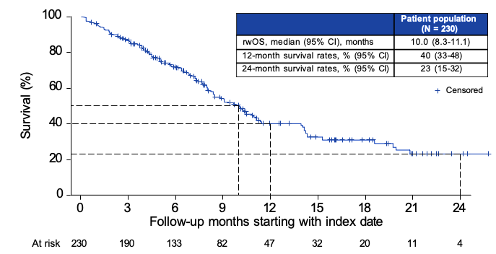
Real-world OS in patients with mTNBC treated with Trodelvy
At median follow-up of 7.2 months:
Median rwOS for patients treated with Trodelvy in 2L+ was 10 months
24 months survival rate was 23% for patients treated with Trodelvy in 2L+
RW OS in patients with mTNBC treated with SG in 2L+ lines
40%
23%
Median rwPFS was 3.8 (3.1-4.3) months among all patients (2L+)
Dashed lines indicate 12-month and 24-month survival rates and median rwOS.
2L, second line; CI, conﬁdence interval; mTNBC, metastatic triple-negative breast cancer; rwOS, real-world overall survival; SG, sacituzumab govitecan.
1. Kalinsky, K., Spring, L., Yam, C. et al. Real-world use patterns, effectiveness, and tolerability of sacituzumab govitecan for second-line and later-line treatment of metastatic triple-negative breast cancer in the United States. Breast Cancer Res Treat (2024).

Slide 32
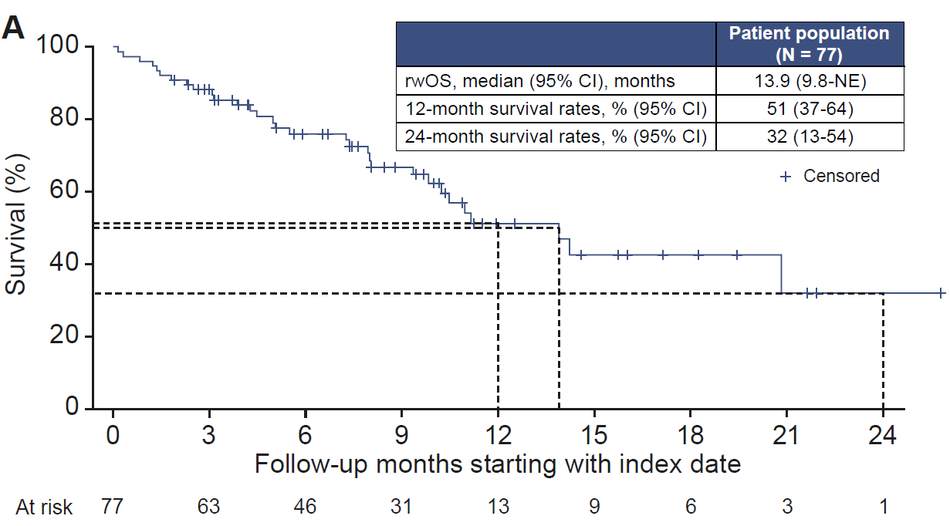
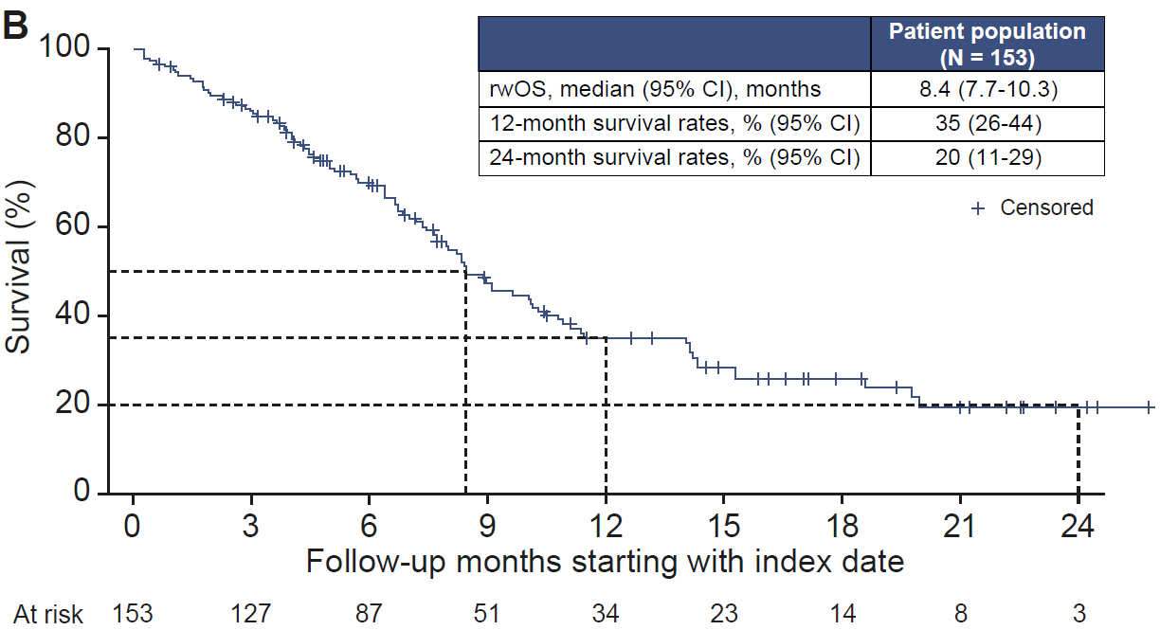
Real-world OS in patients with mTNBC treated with Trodelvy in 2L & 3L+
At a median follow-up of 7.2 months:
Median rwOS for patients treated with Trodelvy in 2L was 13.9 months
Median rwOS for patients treated with Trodelvy in 3L+ was 8.4 months
rw OS in patients with mTNBC treated with SG in 2L
rw OS in patients with mTNBC treated with SG in 3L+
51%
32%
35%
20%
Median rwPFS for 2L patients was 4.9 (2.9-6.0) months and for 3L+ patients was 3.5 (2.7-4.2) months
Dashed lines indicate 12-month and 24-month survival rates and median rwOS.
2L, second line; CI, conﬁdence interval; mTNBC, metastatic triple-negative breast cancer; rwOS, real-world overall survival; SG, sacituzumab govitecan.
1. Kalinsky, K., Spring, L., Yam, C. et al. Real-world use patterns, effectiveness, and tolerability of sacituzumab govitecan for second-line and later-line treatment of metastatic triple-negative breast cancer in the United States. Breast Cancer Res Treat (2024).

Slide 33
rwOS outcomes in stratified analysis
Outcomes were similar to the overall population when stratifying patients by race, concomitant G-CSF use, and treatment-free interval
Clinical outcomes in stratified analyses
 | N | Median rwOS, months (95% CI)
Concomitant G-CSF use with SG Yes No/Undocumented | 134 96 | 9.1 (7.7 – 11.4) 10.2 (8.3 – 14.2
Race White Black | 146 59 | 9.1 (8.0 – 11.1) 10.1 (7.7 – 18.6)
TFIª < 12 months ≥ 12 months | 18 16 | 11.1 (8.0 – NE) 10.9 (5.0 – NE)
ªTFI was defined as time (months) from end date of last systemic anticancer therapy in the (neo)adjuvant setting to date of mTNBC diagnosis. Stratified analyses by TFI were performed among patients with recurrent disease treated with SG in 2L from April 1, 2020, until February 28, 2022, and for whom TFI could be calculated (n = 34).
CI, confidence interval; G-CSF, granulocyte colony-stimulating factor; mTNBC, metastatic triple-negative breast cancer; NE, not estimable; rwOS, real-world overall survival; SG, sacituzumab govitecan; TFI, treatment-free interval.
1. Kalinsky, K., Spring, L., Yam, C. et al. Real-world use patterns, effectiveness, and tolerability of sacituzumab govitecan for second-line and later-line treatment of metastatic triple-negative breast cancer in the United States. Breast Cancer Res Treat (2024).

Slide 34
Real world safety profile
Fatigue was reported in 104 (45%), neutropenia in 77 (33%), and diarrhea in 70 (30%) patients*
Dose reductions and interruptions due to toxicity were observed in 26% and 39% of all patients, respectively; 7% discontinued SG treatment due to toxicities
Concomitant administration of G-CSF was observed in 58% of all patients, with most patients having received G-CSF with prior anticancer treatment
Underreporting of AEs and dose modifications in physicians’ notes may have occurred with an unknown impact on the results; a limitation commonly described in studies using EHR data²⁻⁴
SG treatment discontinuation, dose modifications, and G-CSF use
 | RWE cohort 2L+ mTNBC N = 230
Patients with SG discontinuation, n (%) Due to toxicity^{a,b} | 209 (91) 17 (7)
Patients with SG dose reduction, n (%) Due to toxicity^{a,b} | 79 (34) 59 (26)
Patients with SG dose interruption, n (%) Due to toxicity^{a,b} | 133 (58) 89 (39)
G-CSF usage during SG treatment, n (%) G-CSF usage prior to SG treatment G-CSF usage ﬁrst time during SG treatment | 134 (58) 99 (43) 35 (15)
Median time from SG start date to G-CSF usage (IQR),^{c} days | 8.5 (8.0-29.0)
ªPercentages are based on total number of patients. ^{b}Based on data abstracted from physicians’ notes. ^{c}Among patients initiating G-CSF for the first time during SG treatment.
BC, breast cancer; CI, confidence interval; G-CSF, granulocyte colony-stimulating factor; IQR, interquartile range; NE, not estimable; SG, sacituzumab govitecan; TFI, treatment-free interval.
1. Kalinsky, K., Spring, L., Yam, C. et al. Real-world use patterns, effectiveness, and tolerability of sacituzumab govitecan for second-line and later-line treatment of metastatic triple-negative breast cancer in the United States. Breast Cancer Res Treat (2024). . 2. Kish JK, et al. Breast Cancer Res. 2018;20(1):37. 3. Chen L, et al. J Thorac Dis. 2019;11(11):4474-4483. 4. Price GL, et al. Curr Med Res Opin. 2022;38(8):1319-1331

Slide 35
Summary of Real World Data Analysis
In this real-world analysis, patients with mTNBC treated with Trodelvy in routine clinical care settings in the United States had a median age of 60 years, were racially diverse, and ~1 out of 5 presented with poor ECOG performance status at baseline
Patients with mTNBC who received Trodelvy as 2L or later showed median rwOS of 10.0 months; patients who received Trodelvy as 2L had median rwOS of 13.9 months
Dose reductions and interruptions due to toxicity were observed in 26% and 39% of all patients, respectively; 7% discontinued SG treatment due to toxicities
“Using a real-world, ethnically diverse population of patients with mTNBC presenting with poor prognosis, these data reinforced the findings from ASCENT. In routine clinical practice, SG is an effective treatment in the 2L setting, consistent with treatment guidelines”
35
2L, second line; ECOG, Eastern Cooperative Oncology Group; mTNBC, metastatic triple-negative breast cancer; SG, sacituzumab govitecan; G-CSF, granulocyte colony-stimulating factor; rwOS, real-world overall survival.
1. Kalinsky, K., Spring, L., Yam, C. et al. Real-world use patterns, effectiveness, and tolerability of sacituzumab govitecan for second-line and later-line treatment of metastatic triple-negative breast cancer in the United States. Breast Cancer Res Treat (2024).

Slide 36
Summary of Trodelvy data in 2L and later mTNBC
INDICATION in mTNBC
EFFICACY DATA
SAFETY
In the ASCENT trial
In the ASCENT trial
Indicated & Reimbursed for
Median OS
Familiar & Manageable
2L+ mTNBC˄
~1 YEAR
SAFETY PROFILE
Median OS:
11.8 months with TRODELVY (95% Cl,10.5–13.8)
vs 6.9 months with single-agent chemotherapy
(95% Cl, 5.9–7.7); P<.0001*³
<5% of patients on TRODELVY discontinued due to adverse reactions⁴
NO drug-related deaths in the TRODELVY group⁵
ESMO MCBS score 5 ⁶
ESMO & NCCN guidelines recommend TRODELVY as a preferred treatment option for 2L mTNBC ^^{1,2}
OS rate at 24 Months
HRQoL
20.5% with TRODELVY
(95% CI, 15.4-26.1)
vs 5.5% with TPC (95% CI, 2.8-9.4)⁴
TRODELVY was generally associated with greater improvements and delayed worsening of HRQoL scores compared with TPC⁷
^after 2 lines of systemic therapy, at least 1 for the advanced disease³
TRODELVY special warnings and precautions include traceability, severe or life-threatening neutropenia, severe diarrhoea, hypersensitivity, nausea and vomiting, use in patients with reduced UGT1A1 activity, embryo-foetal toxicity, and sodium.
*Assessed by independent central review in the ITT population. The OS improvement in the primary analysis population (median OS: 12.1 months vs 6.7 months; HR: 0.48; P<.0001) was consistent with the ITT population. The primary analysis population consisted of patients without present or prior history of brain metastases at baseline (n=468). The ITT population consisted of patients with or without brain metastases at baseline (N=529). ITT population final database lock 25 February 2021.¹
2L, second line; CI, confidence interval; ESMO, European Society for Medical Oncology; HR, hazard ratio; ITT, intent-to-treat; mTNBC, metastatic triple-negative breast cancer; OS, overall survival.
1. Gennari A, et al. Ann Oncol. 2021;32(12):1475–1495. 2. Referenced with permission from the NCCN Clinical Practice Guidelines in Oncology (NCCN Guidelines) for Breast Cancer V.4.2022.c National Comprehensive Cancer Network, Inc. 2022. All rights reserved. 2022. To view the most recent and complete version of the guidelines, go online to NCCN.org 3. TRODELVY (sacituzumab govitecan) prescribing information approved by Israeli ministry of health. 4. Bardia A, et al. ASCO 2022. Pster 1071 ; Final results from the phase 3 ASCENT study.
5.Bardia A, et al. N Engl J Med. 2021;384(16):1529-1541 , 5. Rugo H, et al. Poster. SABCS [virtual meeting]. 2020 (abstr PS11- 09). 6. https://www.esmo.org/guidelines/esmo-mcbs/esmo-mcbs-for-solid-tumours/esmo-mcbs-scorecards/scorecard-271-1
7. Loibl S. et al., Health-related quality of life in the phase III ASCENT trial. Euro J Cancer. 2022 Oct 178.
Notes:
אם אסכם, מי המטופלות שיכולות לקבל ערך מטרודלבי?
לפי ההתוויה וגם לפי הגיידליינס ESMO ו-NCCN טרודלבי מומלץ כבר החל מקו שני לmTNBC. למעשה אין סיבה לחכות לקוי טיפול מאוחרים יותר.
היתרונות המשמעותיים של טרודלבי הינם משך OS חציוני של כשנה, משמעותית ארוך יותר מהטיפולים הכימותרפייה הזמינים לקו זה כיום, ושיעור גבוה יותר של שרידות שנתיים לאחר טיפול : 20.5 עם טרודלווי- פי 4 בערך יותר מטופלות שהיו בחיים עם טרודלווי בנקודת זמן זו בהשוואי לכימותרפיה
ולבסוף פרופיל בטיחות מוכר ותופעות לוואי שניתנות לניהול וככלל שמירה טובה יותר על איכות החיים בהשוואה לכימותרפיה במרבית המדדים שנבדקו במחקר ASCENT

Slide 37
Trodelvy
(Sacituzumab Govitecan)
Administration and Safety

Slide 38

TRODELVY dosing and administration¹
Full Indication
mTNBC
Trodelvy as monotherapy is indicated for the treatment of adult patients with unresectable or metastatic triple-negative breast cancer (mTNBC) who have received two or more prior systemic therapies, including at least one of them for advanced disease.
Trodelvy is indicated for the treatment of adult patients with unresectable locally advanced or metastatic HR+/HER2- (IHC 0, IHC 1+ or IHC 2+/ISH–) breast cancer who have received endocrine-based therapy and at least two additional systemic therapies in the metastatic setting.
HR+/HER2-
The recommended dose of TRODELVY is 10 mg/kg body weight administered as an IV infusion once weekly on Day 1 and Day 8 of 21-day treatment cycles.
DAY 1
10 mg/kg
DAY 8
10 mg/kg
Continue treatment
until disease progression
or unacceptable toxicity
Premedication prior to administration
Prior to each dose of Trodelvy®, premedication for prevention of infusion-related reactions and chemotherapy-induced nausea and vomiting (CINV) is recommended.¹
IV, intravenous.
1. TRODELVY (sacituzumab govitecan) prescribing information approved by Israeli ministry of health

Slide 39


Method of administration¹
First infusion | Subsequent infusions
3 hours | 1–2 hours (if prior infusions were tolerated)
Observe patients during the infusion and for ≥30 min after
Infusion period
Observation period
The infusion rate of TRODELVY should be slowed down or infusion interrupted if the patient develops an infusion-related reaction. Hypersensitivity reactions reported up to the end of the day following dosing occurred in 33.0% (227/688) of patients treated with sacituzumab govitecan. Grade 3 and above hypersensitivity occurred in 1.7% (12/688) of patients treated with sacituzumab govitecan. The incidence of hypersensitivity reactions leading to permanent discontinuation of sacituzumab govitecan was 0.1% (1/688).
1. TRODELVY (sacituzumab govitecan) prescribing information approved by Israeli ministry of health.

Slide 40
Pre-infusion medication¹
Consider antiemetic preventive treatment with 2 or 3 medicinal products to prevent and treat chemotherapy-induced nausea and vomiting (CINV), e.g.:
- Dexamethasone with either a 5-HT3 receptor antagonist or NK-1 receptor antagonist
- Other drugs as indicated
Pre-infusion medication is recommended to prevent infusion reactions, e.g.:
- Antipyretics
- H1 and H2 blockers
- Corticosteroids
CINV, Chemotherapy-induced nausea and vomiting.
1. TRODELVY (sacituzumab govitecan) prescribing information approved by Israeli ministry of health

Slide 41
Practical neutropenia management with TRODELVY ¹
Talk to patients about
the possibility of experiencing neutropenia while on TRODELVY
Encourage patients to notify their healthcare team if they experience fever, chills, or other signs of infection
Consider use of
reactive G-CSF to manage neutropenia¹
Dose modifications or interruptions may be required to manage severe neutropenia¹
TRODELVY should not be administered if the absolute neutrophil count is below
1500/mm³ on Day 1 of any cycle or if the neutrophil count is below 1000/mm³ on Day 8 of any cycle. TRODELVY should not be administered in case
of neutropenic fever.¹
1
2
3
4
G-CSF, granulocyte-colony stimulating factor.
1. TRODELVY (sacituzumab govitecan) prescribing information approved by Israeli ministry of health.

Slide 42
Practical diarrhoea management with TRODELVY ¹
Talk to patients about the possibility of experiencing diarrhoea while on TRODELVY
Encourage patients to notify their healthcare team at the first signs or symptoms of severe or persistent diarrhoea
At the onset of diarrhoea, and if no infectious cause can be identified, treatment with loperamide should be
initiated.
Additional supportive measures (e.g. fluid and electrolyte substitution) may also be employed as clinically indicated.¹
Per ASCENT & TROPiCS study: Consider initiating loperamide 4 mg, then 2 mg with every diarrhoea episode, max of 16 mg/day. Discontinue loperamide 12 hours after diarrhoea resolves^{2, 3}
Initiate other supportive measures such as administration of fluids or electrolytes as clinically appropriate¹
Dose modifications or interruptions may be required to manage persistent Grade ≥3 diarrhoea¹
If a patient is experiencing Grade ≥3 diarrhoea at the time of scheduled treatment, TRODELVY should not be administered. When resolved to ≤Grade 1, TRODELVY should be continued.¹
1
2
3
4
Patients who exhibit an excessive cholinergic response to treatment with TRODELVY (e.g. abdominal cramping, diarrhoea, salivation, etc.) can receive appropriate treatment (e.g. atropine) for subsequent treatments with TRODELVY.¹
1. TRODELVY (sacituzumab govitecan) prescribing information approved by Israeli ministry of health. 2. Bardia A, et al. N Engl J Med. 2021;384(16):1529-1541., , 3. Rugo HS, et al. The lancet; August 23, 2023. https://www.thelancet.com/journals/lancet/article/PIIS0140-6736(23)01245-X/fulltext

Slide 43
Dose modifications can be made as needed to help manage neutropenia¹
FIRST
OCCURRENCE
SECOND
OCCURRENCE
THIRD
OCCURRENCE
FOURTH
OCCURRENCE
ADVERSE
REACTION
Grade 4 neutropenia ≥7 days or less if clinically indicated
or
Grade 3-4 febrile neutropenia
or
At time of scheduled treatment, Grade 3–4 neutropenia which delays dosing by 2 or 3 weeks for recovery to ≤Grade 1
25%
50%
Administer
reactive G-CSF
as soon as clinically indicated
dose reduction
(7.5 mg/kg)
administer G-CSF as soon as clinically indicated
dose reduction
(5 mg/kg)
administer G-CSF as soon as clinically indicated
Discontinue
Treatment
administer G-CSF as soon as clinically indicated
At time of scheduled treatment, Grade 3–4 neutropenia which delays dosing beyond 3 weeks for recovery to ≤Grade 1
Discontinue
Treatment,
administer G-CSF as soon as clinically indicated
The sacituzumab govitecan dose should not be re-escalated after a dose reduction for adverse reactions has been made
G-CSF, granulocyte-colony stimulating factor.
1. TRODELVY (sacituzumab govitecan) prescribing information approved by Israeli ministry of health

Slide 44

Dose modifications can be made as needed to help manage diarrhoea and other non-neutropenic toxcity¹
ADVERSE
REACTION
FIRST
OCCURRENCE
SECOND
OCCURRENCE
THIRD
OCCURRENCE
Grade 4 non-hematologic toxicity of any duration,
or
Any Grade 3–4 nausea, vomiting, or diarrhoea due to treatment
that is not controlled with antiemetics and anti-diarrhoeal agents,
or
Other Grade 3–4 non-hematologic toxicity persisting >48 hours despite optimal medical management,
or
At time of scheduled treatment, Grade 3–4 non-neutropenic hematologic or non-hematologic toxicity, which delays dose by 2 or 3 weeks for recovery to ≤Grade 1
25%
50%
dose reduction
(7.5 mg/kg)
dose reduction
(5 mg/kg)
Discontinue
treatment
In the event of Grade 3–4 non-neutropenic hematologic or
non-hematologic toxicity, Grade 3 nausea or Grade 3–4 vomiting, which does not recover to ≤Grade 1 within 3 weeks
Discontinue
treatment
The sacituzumab govitecan dose should not be re-escalated after a dose reduction for adverse reactions has been made
1. TRODELVY (sacituzumab govitecan) prescribing information approved by Israeli ministry of health

Slide 45
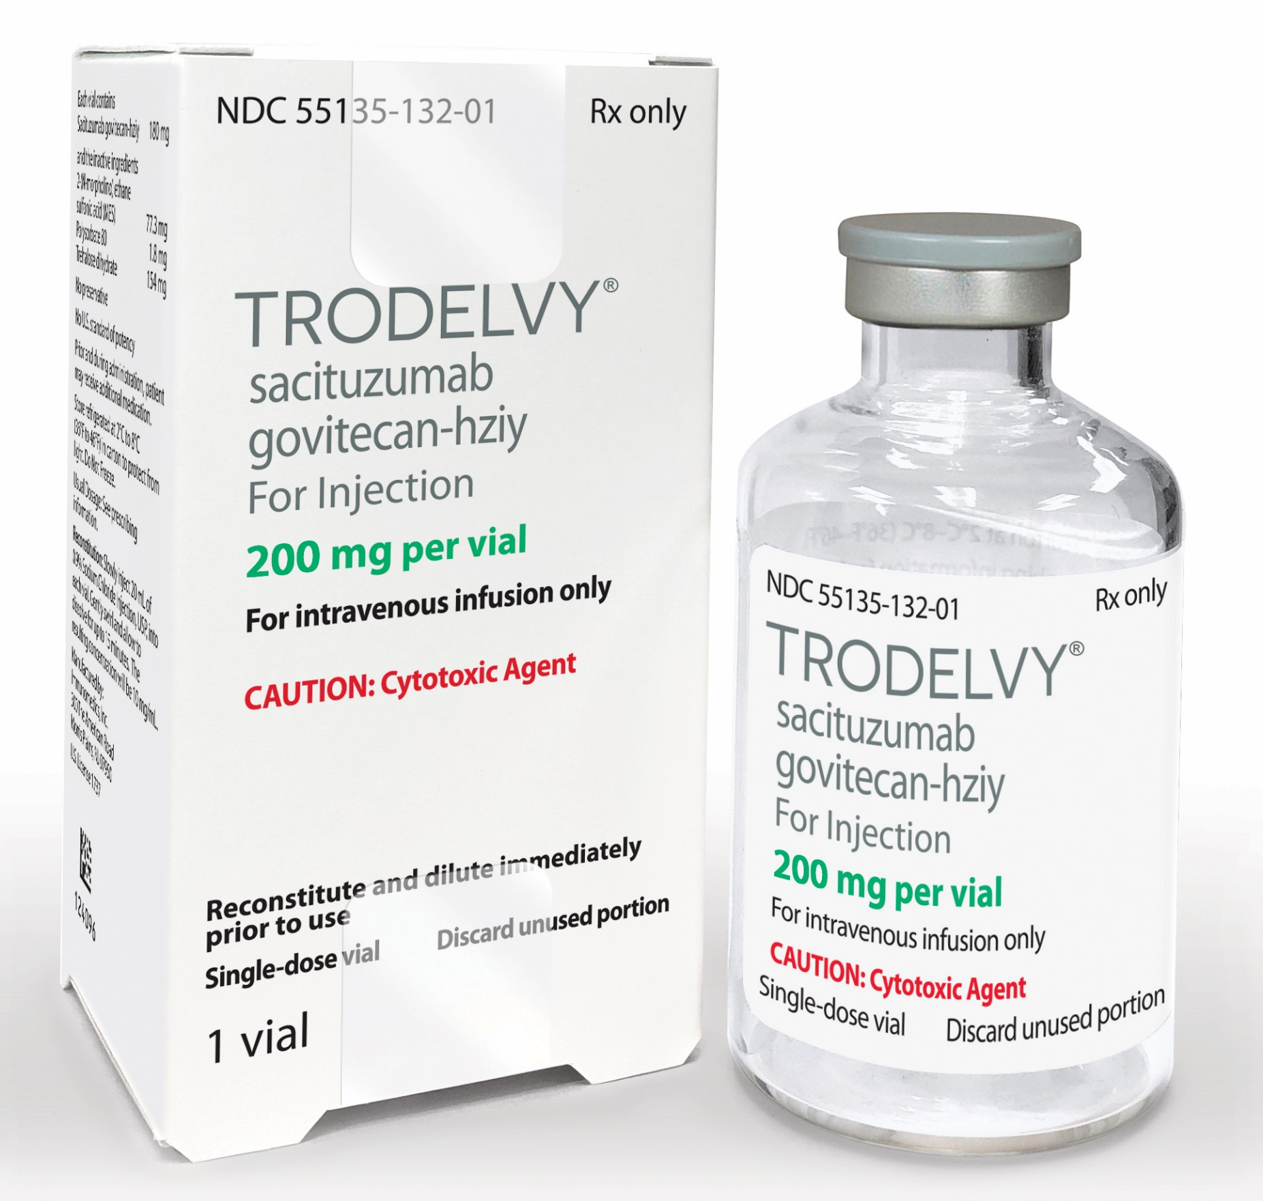

TRODELVY dose is calculated according to patient weight¹
The recommended dose of TRODELVY is 10 mg/kg body weight administered as an IV infusion once weekly on Day 1 and Day 8 of 21-day treatment cycles.
Calculate the required dose (mg)
of TRODELVY based on the patient’s
body weight at the beginning of each treatment
cycle (or more frequently if the patient’s body
weight changed by more than 10% since the
previous administration)
For illustrative purposes only
IV, intravenous; SN-38, active metabolite of irinotecan.
1. TRODELVY (sacituzumab govitecan) prescribing information approved by Israeli ministry of health

Slide 46
Following reconstitution,
TRODELVY must be diluted prior to administration¹
Reconstitution in Preparation of Administration
Dilution of Reconstituted TRODELVY
Prior to Administration
Allow the required number of vials to warm to room temperature
Calculate the required volume of the reconstituted TRODELVY solution to obtain the appropriate dose according to patient’s body weight. Withdraw this amount from the vial(s) using a syringe, discarding any unused portion in the vial(s)
Using a sterile syringe, slowly inject 20 mL of sodium chloride 0.9% solution for injection, into each TRODELVY vial.
The resulting concentration will be 10 mg/mL
Adjust the volume in the infusion bag as needed with sodium chloride 0.9% solution for injection, to obtain a concentration of 1.1 mg/mL to 3.3 mg/mL
Gently swirl vials and allow to dissolve for up to 15 minutes
Do not shake
Slowly inject the required volume of solution into a polyvinyl chloride, polypropylene or ethylene/propylene copolymer infusion bag, to minimize foaming
Do Not Shake the Contents
Use the Diluted Solution in the Infusion Bag Immediately
The solution should be free of visible particulates, clear and yellow.
Do not use the reconstituted solution if it is cloudy or discolored
If not used immediately, the infusion bag containing TRODELVY solution can be stored refrigerated (2°C to 8°C) for up to 24 hours. After refrigeration, administer diluted solution at room temperature up to 25°C within 8 hours (including infusion time)
Do Not Freeze or Shake. Protect From Light
Use immediately to prepare a diluted TRODELVY infusion solution
1. TRODELVY (sacituzumab govitecan) prescribing information approved by Israeli ministry of health

Slide 47
Trodelvy (Sacituzumab Govitecan) in HR+/HER2- metastatic Breast Cancer
Slides set for speakers
Updated on 07/2024
IL-TRO-0270

Slide 48
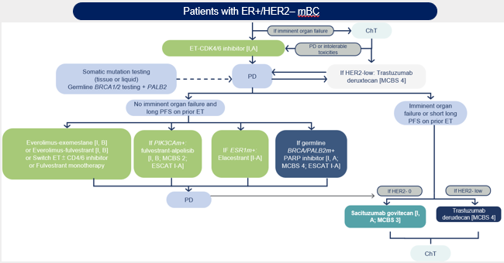
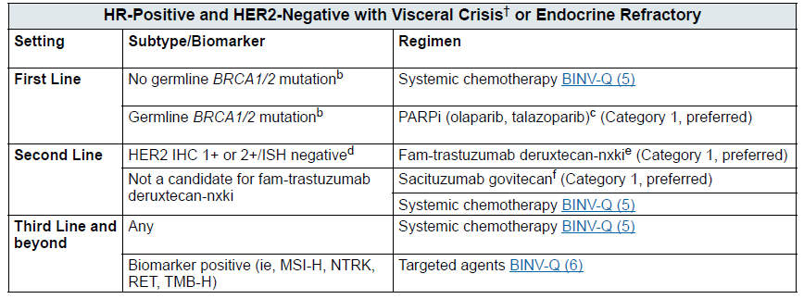
NCCN and ESMO guidelines Consider TRODELVY as a Preferred Treatment For HR+/HER2-
Full Indication
Trodelvy as monotherapy is indicated for the treatment of adult patients with unresectable or metastatic triple-negative breast cancer (mTNBC) who have received two or more prior systemic therapies, including at least one of them for advanced disease.
Trodelvy is indicated for the treatment of adult patients with unresectable locally advanced or metastatic HR+/HER2- (IHC 0, IHC 1+ or IHC 2+/ISH–) breast cancer who have received endocrine-based therapy and at least two additional systemic therapies in the metastatic setting
mTNBC
HR+/HER2-
Contraindications:
Hypersensitivity to the active substance or to any of these excipients:
2-(N-morpholino)ethane sulfonic acid (MES) | Polysorbate 80 (E433) | Trehalose dihydrate
ESMO score 4¹
(HR+/HER2-)
Category 1³
1.ESMO Living Guidelines: https://www.esmo.org/living-guidelines/esmo-metastatic-breast-cancer-living-guideline/er-positive-her2-negative-breast-cancer (May 2023)
2. ESMO score: https://www.esmo.org/guidelines/esmo-mcbs/esmo-mcbs-for-solid-tumours/esmo-mcbs-scorecards/scorecard-374-1
2. NCCN Guidelines: https://www.nccn.org/guidelines/guidelines-detail?category=1&id=1419 (Version4. 2023)

Slide 49
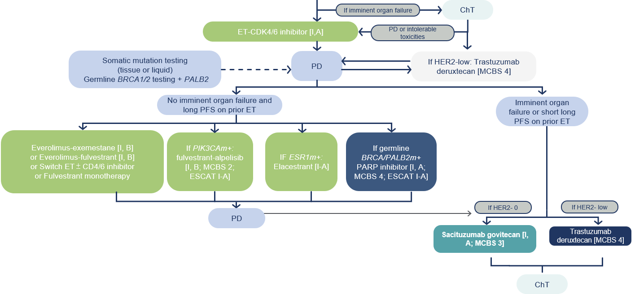
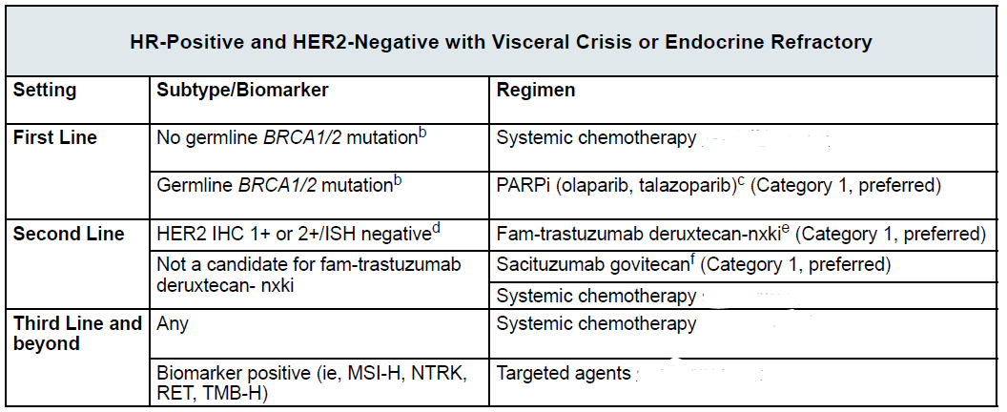
NCCN and ESMO Recommend TRODELVY as Category 1 Preferred (NCCN) and Category 1, A (ESMO) Treatment Option for Pre-treated HR+/HER2- mBC
Sacituzumab govitecan should be considered for patients with HR-positive/HER2-0 MBC after at least two lines of ChT.
NCCN Guidelines Recommended Systemic Therapy Regimens For Recurrent Unresectable (Local or Regional) or Stage IV (M1) Disease²
Living ESMO Guidelines¹
(May 2023)
Patients with ER+/HER2– mBC
CDK4/6, Cyclin Dependent Kinase 4/6; ChT, chemotherapy; ER, oestrogen receptor; ESCAT, ESMO Scale for Clinical Actionability of molecular Targets; ET, endocrine therapy; HER2−, human epidermal growth factor receptor 2-negative; HR, hormone receptor; mBC, metastatic breast cancer; MCBS, ESMO-Magnitude of Clinical Benefit Scale; mTNBC, metastatic triple-negative breast cancer; PALB2, partner and localiser of BRCA2; PARP, poly (ADP-ribose) polymerase; PD, progressive disease; PIK3CA, phosphatidylinositol-4,5-bisphosphate 3-kinase catalytic subunit alpha.
a For treatment of brain metastases, see NCCN Guidelines for Central Nervous System Cancers.
b Assess for germline BRCA1/2 mutations in all patients with recurrent or metastatic breast cancer to identify candidates for PARP inhibitor therapy.
c PARPi can be considered for a later line for those with BRCA1/2 mutation, however available evidence suggests it is more effective if used earlier.
d See Principles of HER2 Testing (BINV-A).
e Maybe considered in a later line for HER2 IHC 1+ or 2+/ISH negative, if not used in second–line.
f Sacituzumab govitecan-hziy may be used for adult patients with HR-positive, HER2-negative metastatic/locally advanced unresectable breast cancer after prior treatment including endocrine therapy, a CDK4/6 inhibitor, and at least two lines of chemotherapy, one of which was a taxane, and at least one of which was in the metastatic setting. It may be considered for later line if not used as second line therapy.
(a) OFS if the patient is premenopausal.
(b) If relapse <12 months after end of adjuvant AI: fulvestrant–CDK4/6 inhibitor (a); if relapse >12 months after end of adjuvant AI: AI–CDK4/6 inhibitor (a).
(c) Preferred if the patient is ESR1 mutation positive [ESCAT score: II-A]. (d)
(d) ESMO-MCBS v1.1 (Cherny, 2017) was used to calculate scores for new therapies/indications approved by the EMA or FDA. The scores have been calculated by the ESMO-MCBS Working Group and validated by the ESMO Guidelines Committee (https://www.esmo.org/guidelines/esmo-mcbs/esmo-mcbs-evaluation-forms).
(e) ESCAT scores apply to genomic alterations only. These scores have been defined by the guideline authors and validated by the ESMO Translational Research and Precision Medicine Working Group. (Mateo, 2018)
(f) Trastuzumab deruxtecan can also be given following adjuvant ChT in the setting of fast progression (DESTINY-Breast04/EMA indication)
Sacituzumab govitecan should be considered for patients with HR-positive/HER2-0 MBC after at least two lines of ChT.
1. ESMO Living Guidelines: https://www.esmo.org/living-guidelines/esmo-metastatic-breast-cancer-living-guideline/er-positive-her2-negative-breast-cancer (May 2023)
2. NCCN Guidelines: https://www.nccn.org/guidelines/guidelines-detail?category=1&id=1419 (Version4. 2023)
Notes:
Purple: general categories or stratification; green: combination of treatments or other systemic treatments; white: other aspects of management; blue: systemic anticancer therapy.
AI, aromatase inhibitor; CDK4/6, cyclin-dependent kinase 4 and 6; ChT, chemotherapy; EMA, European Medicines Agency; ER, estrogen receptor; ESCAT, ESMO Scale for Clinical Actionability of Molecular Targets; ESR1, estrogen receptor 1; ET, endocrine therapy; FDA, Food and Drug Administration; HER2, human epidermal growth factor receptor 2; m, mutation; MBC, metastatic breast cancer; MCBS, ESMO-Magnitude of Clinical Benefit Scale; OFS, ovarian function suppression; PALB2, partner and localiser of BRCA2; PARP, poly (ADP-ribose) polymerase; PD, progressive disease; PFS, progression-free survival; PIK3CA, phosphatidylinositol-4,5-bisphosphate 3-kinase catalytic subunit alpha.
(a) OFS if the patient is premenopausal.
(b) If relapse <12 months after end of adjuvant AI: fulvestrant–CDK4/6 inhibitor (a); if relapse >12 months after end of adjuvant AI: AI–CDK4/6 inhibitor (a).
(c) Preferred if the patient is ESR1 mutation positive [ESCAT score: II-A]. (d)
(d) ESMO-MCBS v1.1 (Cherny, 2017) was used to calculate scores for new therapies/indications approved by the EMA or FDA. The scores have been calculated by the ESMO-MCBS Working Group and validated by the ESMO Guidelines Committee (https://www.esmo.org/guidelines/esmo-mcbs/esmo-mcbs-evaluation-forms).
(e) ESCAT scores apply to genomic alterations only. These scores have been defined by the guideline authors and validated by the ESMO Translational Research and Precision Medicine Working Group. (Mateo, 2018)
(f) Trastuzumab deruxtecan can also be given following adjuvant ChT in the setting of fast progression (DESTINY-Breast04/EMA indication)
ESMO is a Swiss-registered not-for-profit organisation. All fun

Slide 50
TROPiCS-02: A Phase 3 Study of SG in Patients with HR+/HER2– mBC
Metastatic or locally recurrent inoperable HR+/HER2– (IHC0, IHC1+, or ICH2+/ISH–) breast cancer that progressed after^{a,b}:
  At least 1 endocrine therapy, taxane, and CDK4/6 inhibitor in any setting
  At least 2, but no more than 4, lines of chemotherapy for metastatic disease
  Measurable disease by
  RECIST 1.1
  N = 543
Treatment was continued until progression
or unacceptable toxicity
End points
Primary
PFS by BICR
Secondary
OS
ORR, DoR, CBR
by LIR, and BICR
PRO
Safety
Exploratory
OS by HER2 IHC status^{d}
Sacituzumab govitecan
10 mg/kg IV
days 1 and 8, every 21 days
n = 272
R
1:1
Treatment of physician’s choice^{c}
(capecitabine, vinorelbine,
gemcitabine, or eribulin)
n = 271
Stratification:
Visceral metastases (yes/no)
Endocrine therapy in metastatic setting ≥ 6 months (yes/no)
Prior lines of chemotherapies (2 vs 3/4)
ASCO/CAP, American Society of Clinical Oncology/College of American Pathologists; BICR, blinded independent central review; CBR, clinical benefit rate; CDK, cyclin-dependent kinase; DoR, duration of response; HER2–, human epidermal growth factor receptor 2-negative; HR+, hormonal receptor-positive; IHC, immunohistochemistry; ISH, in situ hybridization; IV, intravenously; LIR, local investigator review; ORR, objective response rate; OS, overall survival; PFS, progression-free survival, PRO, patient-reported outcomes; R, randomized; RECIST, Response Evaluation Criteria in Solid Tumors.
ªClinicalTrials.gov. NCT03901339. ^{b}Disease histology based on the ASCO/CAP criteria. ^{c}Single-agent standard-of-care treatment of physician’s choice was specified prior to randomization by the investigator. ^{d}HER2-low was defined as IHC score of 1+, or score of 2+ with negative ISH result; HER2 IHC0 was defined as IHC score of 0.
1. Tolaney S, et al. Final overall survival (OS) analysis from the phase 3 TROPiCS-02 study of sacituzumab govitecan (SG) in patients (pts) with hormone receptor–positive/HER2-negative (HR+/HER2–) metastatic breast cancer (mBC). Presented at ASCO 2023 Abstract #1003.
50

Slide 51
TROPiCS-02:
Demographics and Baseline Characteristics^{1,2}
 | SG (n=272) | TPC (n=271)
Female, n (%) | 270 (99) | 268 (99)
Median age, y (range) | 57 (29-86) | 55 (27-78)
<65 y, n (%) | 199 (73) | 204 (75)
≥65 y, n (%) | 73 (27) | 67 (25)
Race or ethnic group, n (%)
White | 184 (68) | 178 (66)
Black | 8 (3) | 13 (5)
Asian | 11 (4) | 5 (2)
Otherª / Not reported^{b} | 69 (25) | 75 (28)
ECOG PS, n (%)
0 | 116 (43) | 126 (46)
1 | 156 (57) | 145 (54)
Visceral metastases at baseline, n (%) | 259 (95) | 258 (95)
Liver metastases,^{c} n (%) | 229 (84) | 237 (87)
De novo metastatic breast cancer, n (%) | 78 (29) | 60 (22)
 | SG (n=272) | TPC (n=271)
Median time from initial metastatic diagnosis to randomization, mo (range) | 48.5 (1.2- 243.8) | 46.6 (3.0- 248.8)
Prior chemotherapy in (neo)adjuvant setting, n (%) | 173 (64) | 184 (68)
Prior endocrine therapy use in the metastatic setting ≥6 mo, n (%) | 235 (86) | 234 (86)
Prior CDK4/6 inhibitor use, n (%)
≤12 months | 161 (59) | 166 (61)
>12 months | 106 (39) | 102 (38)
Unknown | 5 (2) | 3 (1)
Median prior chemotherapy regimens in the metastatic setting, n (range)^{d} | 3 (0-8) | 3 (1-5)
Median time of 46-48 months from initial metastatic diagnosis
95% of the patients with visceral metastasis
Median of 3 prior chemotherapy regimens in the metastatic setting
ªIncludes American Indian or Alaska Native, Native Hawaiian or other Pacific Islander. ^{b}Not reported indicates local regulators did not allow collection of race or ethnicity information. ^{c}Presence of baseline target/non-target liver metastases per RECIST1.1 by local investigator review. ^{d}The reported number of prior therapies were miscounted at screening for some patients; 9 patients received prior chemotherapy regimens in the metastatic setting outside the per protocol range for inclusion criteria and were included in the intent-to-treat population. CDK4/6, cyclin-dependent kinase 4/6; ECOG PS Eastern Cooperative Oncology Group performance status, ER estrogen receptor, (neo)adjuvant, neoadjuvant or adjuvant; PR progesterone receptor; SG, sacituzumab govitecan; TPC, treatment of physician’s choice.
Study of Sacituzumab Govitecan-hziy Versus Treatment of Physician's Choice in Participants With HR+/HER2- Metastatic Breast Cancer (TROPiCS-02) (NCT03901339): https://classic.clinicaltrials.gov/ct2/show/NCT03901339
1. Rugo HS, et al. J Clin Oncol. 2022. doi: 10.1200/JCO.22.01002; 2. Rugo HS, et al. ASCO 2022. abstr LBA 1001.
Notes:
MAIN MESSAGE: ​
TROPiCS-2 is a phase 3 study which evaluated sacituzumab govitecan versus treatment of physician’s choice chemotherapy in patients with HR+/HER2- mBC after ET resistance and ≥2 and ≤4 lines of chemotherapy in the metastatic setting.
In TROPiCS-02 patients were required to have received prior endocrine therapy, a CDK4/6 inhibitor, and prior taxane therapy in any setting, as well as at least two but not more than 4 chemotherapies in the metastatic setting.
In this planned second interim analysis, we are presenting data from the key secondary endpoint OS and update on subsequent secondary endpoints results.
​
KEY POINT(S):
At study initiation, 543 patients were randomized to receive SG or a single-agent chemotherapy of the physician’s choice.
At baseline, all patients enrolled in the TROPiCS-2 study had HR+/HER2- mBC diagnosis based on ASCO/CAP criteria.
To be eligible for the study, patients were required to have at least 2 but no more than 4 lines of chemotherapies for metastatic disease; 1 of which could be neoadjuvant therapy if progression occurred within a 12-month period after completion of neoadjuvant therapy.
Patients were randomized 1:1 to receive either:
SG 10 mg/kg IV on days 1 and 8 of every 21-day cycle, or
Single-agent chemotherapy of physician’s choice until progression or unacceptable toxicity
The primary endpoint was PFS, measured by an independent, centralized, and blinded group of radiology experts who assessed tumor response using RECIST v1.1 criteria.
Secondary endpoints included OS, ORR, DOR, CBR by LIR and BICR, PRO and safety.
Patients were stratified according to:
Visceral metastases (yes/no)
Endocrine therapy in metastatic setting ≥6 months (yes/no)
Prior lines of chemotherapies (2 vs 3/4)

Slide 52
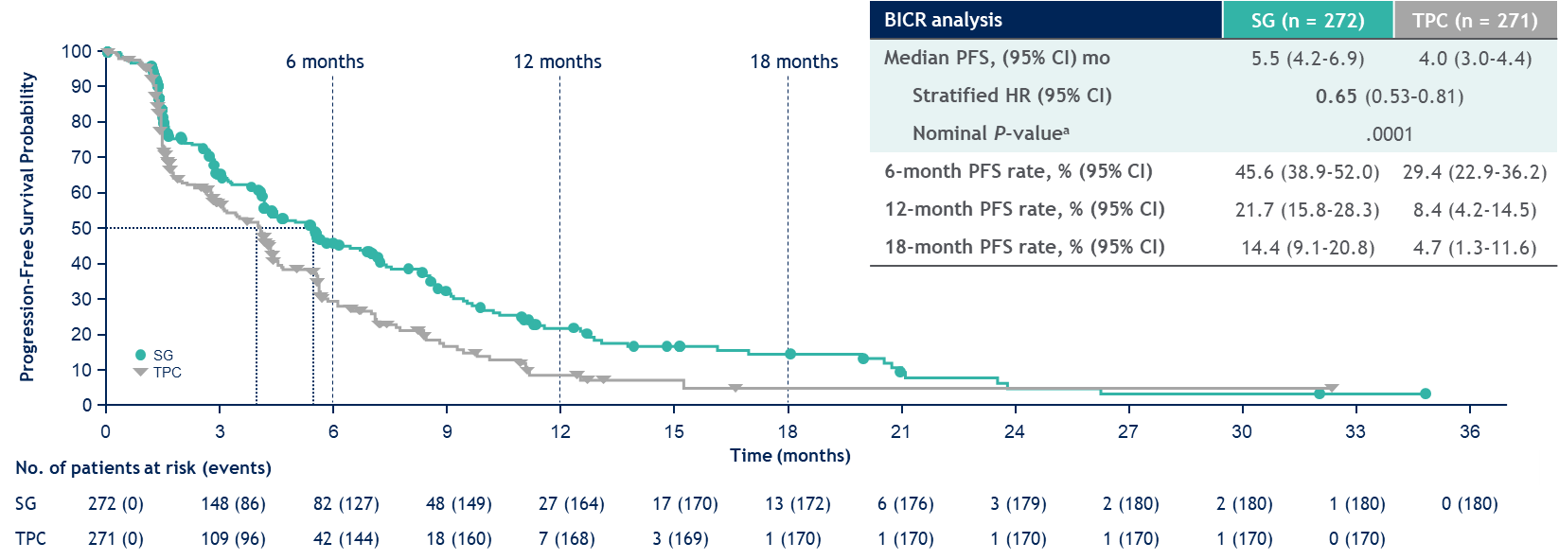
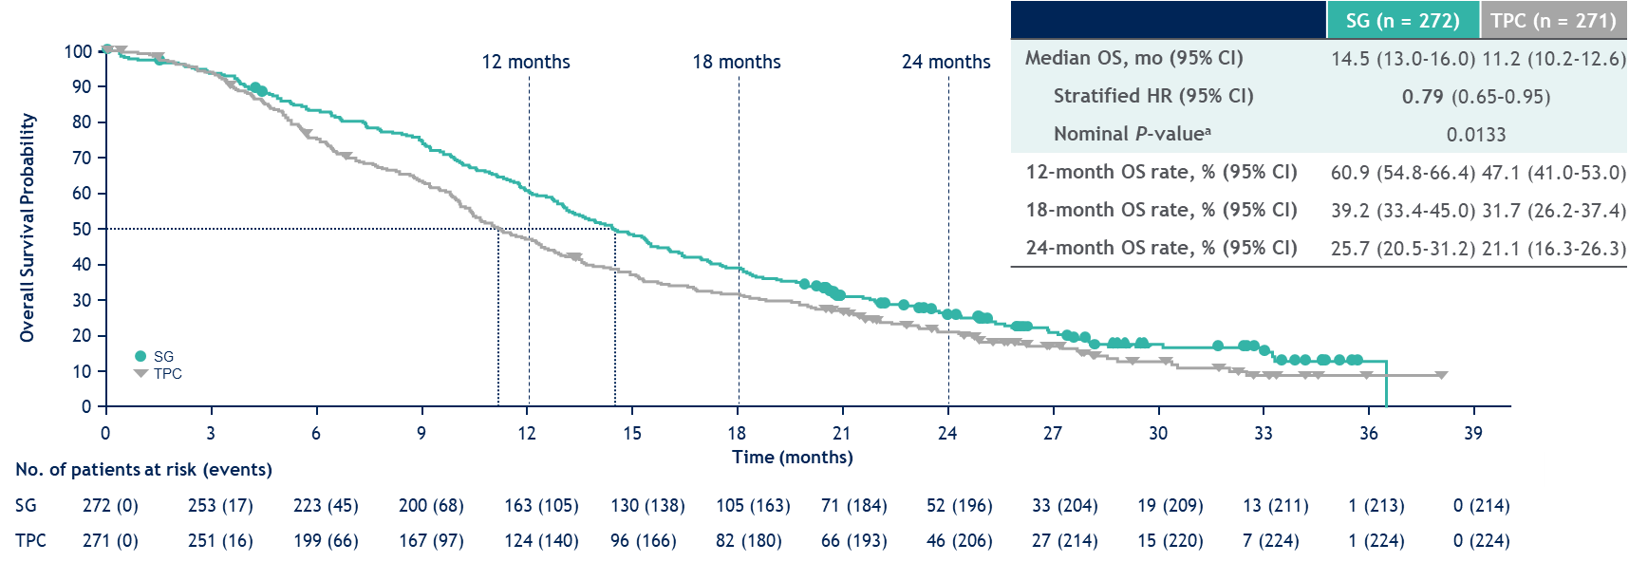
TROPiCS-02 Final Analysis:
Progression-Free and Overall Survival^{1,2}
Progression-Free Survival
Overall Survival²
BICR analysis | SG (n=272) | TPC (n=271)
Median PFS, (95%, CI) mo Stratified HR (95% CI) Nominal P-valueª | 5.5 (4.2-6.9) | 4.0 (3.0-4.4)
Stratified HR (95% CI) | 0.65 (0.53-0.81) 0.0001
6-mo PFS rate, (95% CI) | 45.6 (38.9-52.0) | 29.4 (22.9-36.2)
12-mo PFS rate, (95% CI) | 21.7 (15.8-28.3) | 8.4 (4.2-14.5)
18-mo PFS rate, (95% CI) | 14.4 (9.1-20.8) | 4.7 (1.3-11.6)
BICR analysis | SG (n=272) |  | TPC (n=271)
Median OS, (95%, CI) mo | 14.5 (13.0-15.7) |  | 11.2 (10.1-12.7)
Stratified HR (95% CI) Nominal P-valueª | 0.79 (0.65-0.96) 0.02 | 0.79 (0.65-0.96)
12-mo OS rate, (95% CI) | 61% (55-66) |  | 47% (41-53)
18-mo OS rate, (95% CI) | 39% (33-45) |  | 32 (27-38)
24-mo OS rate, (95% CI) | 25% (19-31) |  | 21% (16-27)
SG continued to demonstrate improvement in PFS and OS vs TPC at longer follow-up, with 35% and 21% reduction in risk of disease progression or death, and a higher proportion of patients remained alive and progression-free at each landmark
ªStratified log rank P-value.
BICR, blinded independent central review; CI, confidence interval; HR, hazard ratio; PFS, progression-free survival; OS, overall survival; SG, sacituzumab govitecan; TPC, treatment of physician’s choice.
Study of Sacituzumab Govitecan-hziy Versus Treatment of Physician's Choice in Participants With HR+/HER2- Metastatic Breast Cancer (TROPiCS-02) (NCT03901339): https://classic.clinicaltrials.gov/ct2/show/NCT03901339
1. Tolaney S, et al. Final overall survival (OS) analysis from the phase 3 TROPiCS-02 study of sacituzumab govitecan (SG) in patients (pts) with hormone receptor–positive/HER2-negative (HR+/HER2–) metastatic breast cancer (mBC). Presented at ASCO 2023 Abstract #1003. 2. H.S Rugo et al. overall survival (OS) analysis from the phase 3 TROPiCS-02 study of sacituzumab govitecan (SG) in patients (pts) with hormone receptor–positive/HER2-negative (HR+/HER2–) metastatic breast cancer (mBC), The Lancet, 2023
52

Slide 53
TROPiCS-02:
ORR, Best Overall Responses, CBR, DoR Responses¹
BICR analysis | SG (n = 272) | TPC (n = 271)
ORR*, n (%) | 57 (21) | 38 (14)
Odds ratio (95% CI) | 1.63 (1.03-2.56), P = .035
Best overall response*, n (%)
CR | 2 (1) | 0
PR | 55 (21) | 38 (14)
SD | 142 (52) | 106 (39)
SD ≥ 6 mo | 35 (13) | 22 (8)
PD | 58 (21) | 76 (28)
NE | 15 (6) | 51 (19)
CBR†, n (%) | 92 (34) | 60 (22)
Odds ratio (95% CI) | 1.80 (1.23-2.63), P = .0025
Median DoR, mo (95% CI) | 8.1 (6.7-9.1) | 5.6 (3.8-7.9)
SG improved ORR and CBR with prolonged DoR compared with TPC
BICR, blinded independent central review; CBR, clinical benefit rate; CI, confidence interval; CR, complete response; DoR, duration of response; NE, not evaluable; NR, not reached; ORR, objective response rate; PD, progressive disease; PR, partial response; SD, stable disease; SG, sacituzumab govitecan; TPC, treatment of physician’s choice; Trop-2, trophoblast cell surface antigen 2.
On the basis of the statistical testing hierarchy, ORR was tested sequentially for significance given that overall survival was significant. ORR was not formally tested previously.13 HR=hazard ratio. OR=odds ratio. ORR=objective response rate.
*Assessed by masked independent central review per the Response Evaluation Criteria in Solid Tumours version 1.1.
†Clinical benefit rate is defined as the proportion of patients with a confirmed best overall response of complete response, partial response, and stable disease for 6 months or longer.
1. H.S Rugo et al. overall survival (OS) analysis from the phase 3 TROPiCS-02 study of sacituzumab govitecan (SG) in patients (pts) with hormone receptor–positive/HER2-negative (HR+/HER2–) metastatic breast cancer (mBC), The Lancet, 2023
53
Notes:
MAIN MESSAGE:
SG improved ORR, best overall responses, and CBR with prolonged DoR compared with TPC at longer follow-up, consistent with previous analysis
KEY POINTS:
As seen on slide
REFERENCES:
Rugo HS, et al. Oral presentation at ESMO Congress; September 9-13, 2022; Paris, France. Abstract LBA76;
Tolaney S, et al. Final overall survival (OS) analysis from the phase 3 TROPiCS-02 study of sacituzumab govitecan (SG) in patients (pts) with hormone receptor–positive/HER2-negative (HR+/HER2–) metastatic breast cancer (mBC). Presented at ASCO 2023 Abstract #1003.
ABBREVIATIONS:
BICR, blinded independent central review; CBR, clinical benefit rate; CI, confidence interval; CR, complete response; DoR, duration of response; NE, not evaluable; NR, not reached; ORR, objective response rate; PD, progressive disease; PR, partial response; SD, stable disease; SG, sacituzumab govitecan; TPC, treatment of physician’s choice; Trop-2, trophoblast cell surface antigen 2.

Slide 54
TROPiCS-02: Safety Summary¹
TEAEs,ª n (%) |  | SG (n = 268) |  | TPC (n = 249)
TEAEs, n (%) |  | Any grade | Grade ≥ 3 | Any grade | Grade ≥ 3
Hematologic | Neutropenia^{b} | 189 (71) | 140 (52) | 136 (55) | 97 (39)
 | Anemia^{c} | 98 (37) | 20 (7) | 69 (28) | 8 (3)
 | Thrombocytopenia^{d} | 17 (6) | 1 (<1) | 41 (16) | 9 (4)
Gastrointestinal | Diarrhea | 166 (62) | 27 (10) | 57 (23) | 3 (1)
 | Nausea | 157 (59) | 3 (1) | 87 (35) | 7 (3)
 | Constipation | 93 (35) | 1 (<1) | 61 (24) | 0
 | Vomiting | 64 (24) | 3 (1) | 39 (16) | 4 (2)
 | Abdominal pain | 53 (20) | 10 (4) | 34 (14) | 2 (1)
Other | Alopecia | 128 (48) | 0 | 46 (18) | 0
 | Fatigue | 105 (39) | 16 (6) | 82 (33) | 9 (4)
 | Asthenia | 62 (23) | 6 (2) | 50 (20) | 5 (2)
 | Decreased appetite | 57 (21) | 4 (1) | 52 (21) | 2 (1)
 | Dyspnea | 49 (18) | 5 (2) | 39 (16) | 11 (4)
 | Headache | 44 (16) | 1 (<1) | 36 (14) | 2 (1)
 | Pyrexia | 39 (15) | 2 (1) | 45 (18) | 0
 | AST increased | 33 (12) | 4 (1) | 44 (18) | 8 (3)
The most common grade ≥ 3 TEAEs were neutropenia (52%), diarrhea (10%), and anemia (7%) in the SG group, and neutropenia (39%), thrombocytopenia (4%), fatigue (4%), and dyspnea (4%) in the TPC group
TEAE, treatment-emergent adverse event; SG, sacituzumab govitecan; TPC, treatment of physician’s choice.
TEAEs were defined as any AEs that began or worsened on or after the start of study drug through 30 days after the last dose of study drug.
ªKey any-grade and grade ≥ 3 TEAEs were defined as those occurring in ≥ 15% and ≥ 10% of patients in 1 arm, respectively. ^{b}Combined preferred terms of “neutropenia” and “neutrophil count decreased.” ^{c}Combined preferred terms of “anemia,” “hemoglobin decreased,” and “red blood cell count decreased.” ^{d}Combined preferred terms of preferred terms of “anemia,” “hemoglobin decreased,” and “red blood cell count decreased.” dCombined preferred terms of “thrombocytopenia” and “platelet count decreased.” Study of Sacituzumab Govitecan-hziy Versus Treatment of Physician's Choice in Participants With HR+/HER2- Metastatic Breast Cancer (TROPiCS-02) (NCT03901339): https://classic.clinicaltrials.gov/ct2/show/NCT03901339
1. Tolaney S, et al. Final overall survival (OS) analysis from the phase 3 TROPiCS-02 study of sacituzumab govitecan (SG) in patients (pts) with hormone receptor–positive/HER2-negative (HR+/HER2–) metastatic breast cancer (mBC). Presented at ASCO 2023 Abstract #1003.
Notes:
MAIN MESSAGE:
Overall, the safety profile of SG in this analysis was consistent with that of previous studies of SG, and no new safety signals emerged with further follow-up
KEY POINT(S):
TEAEs leading to treatment discontinuation happened in 6% of patients in the SG group and 4% in the TPC group.
TEAEs leading to dose delay happened in 66% of patients in the SG group and 44% in the TPC group.
TEAEs leading to dose reductions happened in 33% in the SG arm and 34% in the TPC arm.
TE SAEs happened in 28% of patients in the SG arm and 19% in the TPC arm.
Of the 6 TEAEs leading to death, only 1 was considered by the investigator as treatment-related, i.e. septic shock due to neutropenic colitis. The other 5 were: COVID-19 pneumonia, pulmonary embolism, pneumonia, nervous system disorder, and arrhythmia. Upon detailed review of the TEAEs leading to death, there were no patterns identified.

Slide 55
Summary of Trodelvy data in HR+/HER2− mBC
INDICATION
EFFICACY DATA⁴
SAFETY
In the TROPiCS 02 trial
In the TROPiCS 02 trial
For use in:
Median OS was 3.2 months
longer with TRODELVY
Median OS
PRETREATED
HR+/HER2− mBC¹
14.4 month
Familiar & Manageable
ESMO MCBS score 4 ⁵
with TRODELVY
vs 11.2 months with chemotherapy
HR: 0.79 (95% CI: 0.67–0.96); P=.0200
SAFETY PROFILE ^{1,4}
Criteria for treatment with TRODELVY:
IHC Status 0, 1+, or 2+/ISH−
Prior endocrine-based therapy
2 prior systemic therapies (metastatic setting)
6% of patients on TRODELVY discontinued due to adverse events
OS rate at 12 Months
61% with TRODELVY
considered as preferred treatment as indicated in the NCCN and ESMO guidelines^{2,3}
vs 47% with single-agent chemotherapy
TRODELVY as monotherapy is indicated for the treatment of adult patients with unresectable or metastatic HR+/HER2– (IHC 0, IHC 1+ or IHC 2+/ISH−) breast cancer who have received endocrine-based therapy and at least two additional systemic therapies in the metastatic setting.
TRODELVY special warnings and precautions include traceability, severe or life-threatening neutropenia, severe diarrhoea,
hypersensitivity, nausea and vomiting, use in patients with reduced UGT1A1 activity, embryo-foetal toxicity, and sodium.
CI, confidence interval; HR, hazard ratio; HR+/HER2− mBC, hormone receptor-positive, human epidermal growth factor receptor-negative metastatic breast cancer; IHC, immunohistochemistry;
ISH, in situ hybridization; IV, intravenous; mOS, median overall survival; PFS, progression-free survival; RECIST, Response Evaluation Criteria in Solid Tumours.
TRODELVY (sacituzumab govitecan) Summary of Product Characteristics. Gilead Sciences Ireland UC. 2. ESMO: ESMO ​Metastatic Breast Cancer Living Guideline | ESMO 3. NCCN: https://www.nccn.org/guidelines/guidelines-detail?category=1&id=1419
4. Tolaney S, et al. Final overall survival (OS) analysis from the phase 3 TROPiCS-02 study of sacituzumab govitecan (SG) in patients (pts) with hormone receptor–positive/HER2-negative (HR+/HER2–) metastatic breast cancer (mBC). Presented at ASCO 2023 Abstract #1003. 5. ESMO SCORE: ESMO-MCBS Scorecards | ESMO
Notes:
אם אסכם, מי המטופלות שיכולות לקבל ערך מטרודלבי?
לפי ההתוויה וגם לפי הגיידליינס ESMO ו-NCCN טרודלבי מומלץ כבר החל מקו שני לmTNBC. למעשה אין סיבה לחכות לקוי טיפול מאוחרים יותר.
היתרונות המשמעותיים של טרודלבי הינם משך OS חציוני של כשנה, משמעותית ארוך יותר מהטיפולים הכימותרפייה הזמינים לקו זה כיום, ושיעור גבוה יותר של שרידות שנתיים לאחר טיפול : 20.5 עם טרודלווי- פי 4 בערך יותר מטופלות שהיו בחיים עם טרודלווי בנקודת זמן זו בהשוואי לכימותרפיה
ולבסוף פרופיל בטיחות מוכר ותופעות לוואי שניתנות לניהול וככלל שמירה טובה יותר על איכות החיים בהשוואה לכימותרפיה במרבית המדדים שנבדקו במחקר ASCENT

Slide 56

Trodelvy® (sacituzumab govitecan 200 mg) Powder for concentrate for solution for infusion
INDICATION: Trodelvy as monotherapy is indicated for the treatment of adult patients with unresectable or metastatic triple-negative breast cancer (mTNBC) who have received two or more prior systemic therapies, including at least one of them for advanced disease.
Trodelvy is indicated for the treatment of adult patients with unresectable locally advanced or metastatic hormone receptor (HR)-positive, human epidermal growth factor receptor 2 (HER2)-negative (IHC 0, IHC 1+ or IHC 2+/ISH–) breast cancer who have received endocrine-based therapy and at least two additional systemic therapies in the metastatic setting.
For further information please refer to approved prescribing information as available at Israeli ministry of health website:
https://israeldrugs.health.gov.il/#!/byDrug
לדווח תופעת לוואי
©2024 Gilead Sciences Israel Ltd., IL-TRO-0291

